Slide 1
РОССИЙСКАЯ РЕВОЛЮЦИЯ

Slide 2
Russian Revolution-Causes
Absolute Monarchy
Czar Nicholas II
1905 Revolution
“workers” complaints delivered to Czar
Guards fire upon crowds – “Bloody Sunday”
Protests sweep across Russia
October Manifesto
Czar agrees to give people representation – Duma – Czar ignores Duma

Slide 3
Russian Revolution-Causes
Czar Nicholas II abolishes Duma; political parties harassed
Rapid industrialization – workers’ problems
Rasputin – lowers confidence in Czar
Czar Nicholas II abdicates throne
Sets up provisional government – Kerensky
Mensheviks
World War I – continues fighting

Slide 4
Russia during WWI
Russian army-poorly equipped, poorly led, corrupt
Ottoman Emp. cuts supply routes goods difficult to come by-inflation
People have lost faith in gov’t
Soldiers side with people
Czar forced to abdicate Mar. 1917
Provisional gov’t-continues war

Slide 5
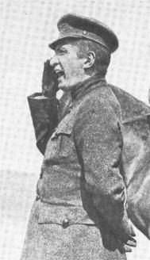
The March Revolution
Origins: Food riots and strikes
Duma declared itself a Provisional Government on March12th
Tsar abdicated on March 17th
Composition of the Provisional Government--Alexander Kerensky
Very Popular Revolution
The Petrograd Soviet

Slide 6
Lenin/Bolsheviks
“Petrograd Soviet of Workers’ and Soldiers’ Deputies”
Socialists
Political equality
Economic equality
Land reforms
Peace
“Soviets” are set up all over Russia

Slide 7
Lenin/Bolsheviks
Bolsheviks gain control of the soviets over moderate Mensheviks
Leader: Vladimir Lenin
Revolutionary socialist-Marxist
Proletariat/bourgeoisie
“Peace, Bread, and Land”
Bolsheviks overthrow provisional gov’t 11/7/17 (October Revolution)
Rename themselves the Communist Party

Slide 8
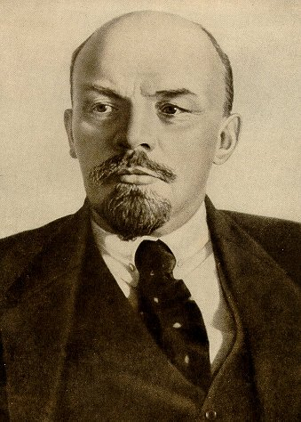
Bolshevism: Vladimir Lenin
His Early Years
--Exiled to Siberia in 1897
Committed to Class Struggle and Revolution
Moved to London in 1902 and befriended Leon Trotsky

Slide 9
Civil War
Lenin signs peace treaty with Germans-give up much territory
Civil War-opponents incl. Mensheviks-known as “Whites”
Want to restore monarchy
Allies angered by Bolsheviks
support Whites with arms, money, troops

Slide 10
Peace
Communists/Lenin execute Czar and entire family
Communists win Civil War by 1921
Rename Russia
Union of Soviet Socialist Republics (USSR)

Slide 11
Vocabulary/Terms
Duma
Abdicate
Leon Trotsky
Soviet
Menshevik
Bolshevik
Inflation
Bloody Sunday
Proletariat
Alexander Kerensky
Communist Party
Communism
Red Army
Whites
Marxism
Vladimir Lenin
Absolute Monarchy
October Manifesto
Marxism-Leninism
Bourgeoisie

Slide 12
NOTES TEST (16 points)
Russian word meaning council: __________
Czar of Russia abdicates: mo/yr __________
Bolshevik leader: ____________
“October Revolution” takes place: mo/yr ___
Bolsheviks rename themselves: _________
1921 Russia is renamed: _____________
Slogan of the Bolsheviks: ___________
Mensheviks were known as the: ________

