Slide 1
The End (of WWII)

Slide 2
Turning Point Offensives
Battle of Stalingrad-1943
  Soviets defeat Germans
North Africa-May 1943
  Eisenhower (US)/Montgomery (GB) trap Rommel (GM); Italy retreats-leaves Africa
Italy/Balkans- “soft underbelly of the Axis”
  Allies take Sicily; Mussolini (IT) forced to resign; new premier dissolves Fascist Party, agrees to stop war on Allies, declares war on Germany

Slide 3
Air/Sea War
US/British bombing raids on Germany, bomb nearly every city
Planes also protect shipping routes
Battle of the Coral Sea-May 1942
  US/AUS air/naval forces defeat JP
Battle of Midway-June 1942
  Begins to turn tide of war

Slide 4
Air/Sea War
Guadalcanal-Aug 1942-Feb 1943
  First invasion of Japanese-held territory
  Protects AUS supply line
1943 allies take offensive
  “island hopping”

Slide 5
V-E Day May 8, 1945
Operation Overlord
  Allied invasion of NW France
  June 6, 1944 D-Day, landing at Normandy, in Paris w/in 2 mo.
  September at Siegfried Line along Germany’s western edge

Slide 6
V-E Day: May 8, 1945
Soviets began major drive from east
Allies turn back Germans at Battle of the Bulge (late 1944)
April 1945 German army in Italy surrenders
Soviet and Allied armies meet
April 30 Hitler commits suicide
May 2 Soviets take Berlin
German high command surrenders

Slide 7
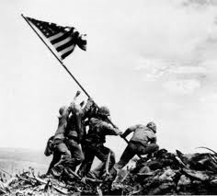
V-J Day: September 2, 1945
Operation Detachment: Allies take Iwo Jima-Mar ’45
  Only battle where US marine casualties exceed JP casualties
Operation Iceberg: Allies take Okinawa-June ‘45
  36 Allied ships sunk, 368 damaged, 200,000 casualties, 50,000-150,000 civilian casualties
Allies demand unconditional surrender; Japan refuses

Slide 8
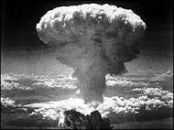
V-J Day: Sep. 2, 1945
August 6, 1945 Hiroshima
August 8 Soviets declare war on Japan-take Manchuria
August 9, 1945 Nagasaki
August 14, 1945 Japan surrenders

Slide 9
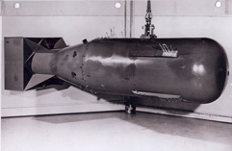
Hiroshima
August 6, 1945
B-29 Superfortress bomber Enola Gay
“Little Boy” – equivalent to 20,000 tons TNT
70,000 killed immediately; 200,000 more by 1950 died from radiation exposure

Slide 10
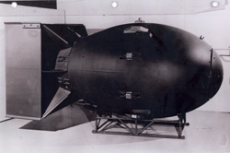
Nagasaki
August 9, 1945
B-29 Superfortress Bock’s Car
“Fat Man” equivalent to 21 kilotons of TNT
70,000-80,000 died within the year
Blast generated heat of 7050◦F and winds of 624 mph

Slide 11
Yalta/Potsdam
Yalta-Feb ‘45-Roosevelt, Churchill, Stalin-agree to divide/occupy Germany-Soviets to enter war against Japan
Potsdam-Jul ‘45-Truman, Attlee (GB), Stalin-plan German occupation-agree to an unconditional surrender of Japan

Slide 12
WAR COSTS
22 million military personnel killed
34 million wounded
Europe/Asia 16 million civilians died
Holocaust
Bataan Death March-Japanese soldiers force 78,000 POWs to march 55 miles killing 600 Americans & 10,000 Filipinos
Soviets sent 1.5 million Poles to concentration camps, 100,000 killed
American use of nuclear weapons

Slide 13
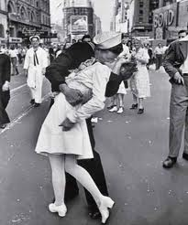
VOCABULARY
“soft underbelly of the Axis”
Island hopping
Operation Overlord
V-E Day
D-Day
V-J Day
Operation Iceberg
Operation Detachment

