Slide 1
Vocab. Warm ups
7-4.5 World War II
7-4.6 Holocaust

Slide 2
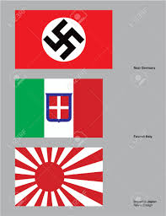
Monday, March 07, 2016
Axis Alliance –alliance agreement between Germany, Italy, and Japan in 1936
Neutrality Acts –prohibited the U.S.A. from loaning money or selling weapons to countries at war

Slide 3
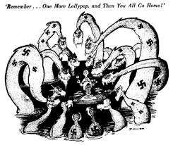
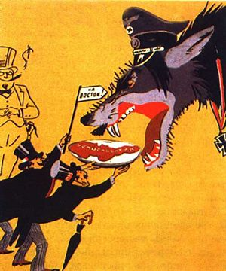
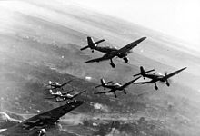
Monday, March 07
appeasement –giving in to reasonable demands in order to avoid conflict
5. blitzkrieg –”lightening war”
Munich Conference 1938 –British/French allowed Hitler to take the Sudetenland if he would take nothing else

Slide 4
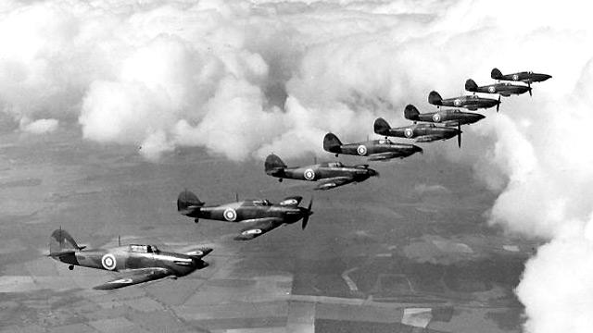
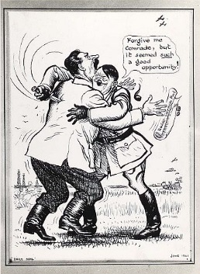
Tuesday, March 08
Soviet Non-Aggression Pact –agreement between Hitler and Stalin(1939) –Germany agreed not to attack Soviet Union
Battle of Britain (19940-1941) –German air force bombed Great Britain unsuccessfully

Slide 5
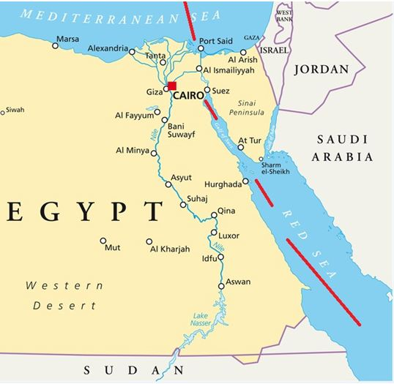
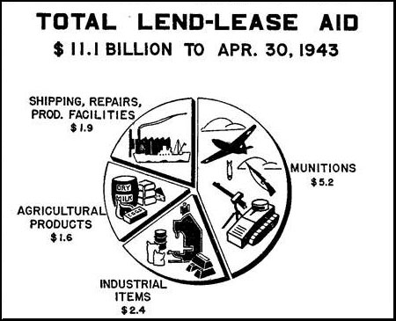
Tuesday, March 08
Suez Canal –connects the Mediterranean Sea to the Red Sea wanted by Germany
9. cash and carry policy – United States aid to Great Britain that did not cause U.S. To lose its position of neutrality
Lend-Lease Act –allowed U.S.A. to lend or lease weapons/supplies to countries important to US interests

Slide 6
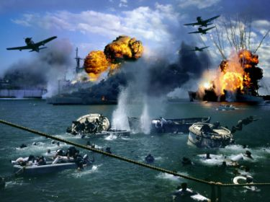
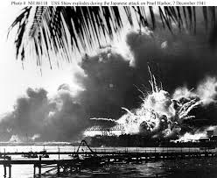
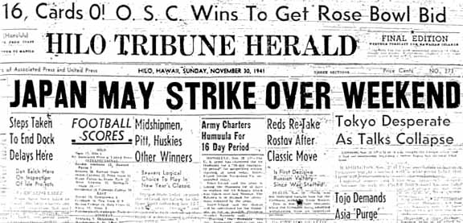
Wednesday March 09
11. Pearl Harbor-U.S. naval base in Hawaii attached by Japanese December 7, 1941
12. economic sanctions –trade restrictions
13. oil embargo –U.S. refused to trade with Japan because of their invasion of Indochina to stop further aggression

Slide 7
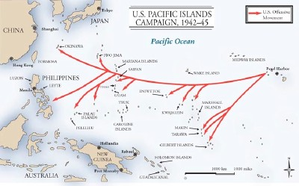
Wednesday March 09
“island hopping” –(strategy in WWII)- allowed US to bypass islands heavily secured by Japan to reach islands closer to main islands
15. Invasion of Normandy (D-Day) –Allied forces stormed beaches to attempt to liberate France June 6, 1944

Slide 8
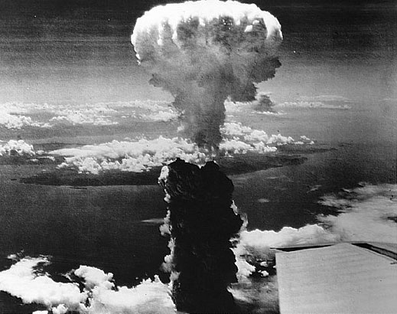
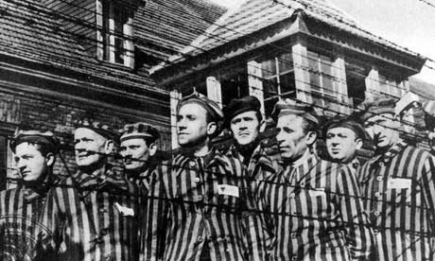
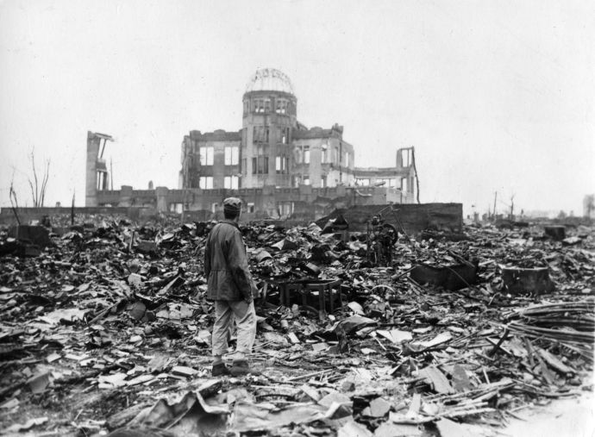
Thursday March 10
15. Hiroshima/Nagasaki –Japanese cities where the atomic bomb was dropped
16. Holocaust –a plan by Hitler to ensure German supremacy by eliminating Jews, non-conformists, homosexuals, non-Aryans, and the mentally and physically disabled

Slide 9
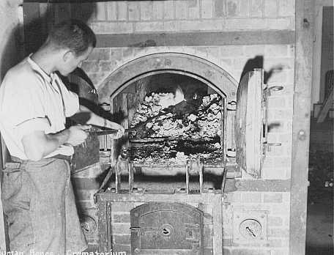
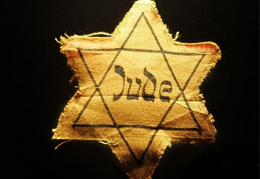
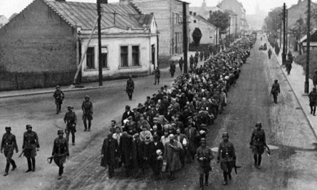
Thursday March 10
The Final Solution –Nazi Germany’s plan and execution of its systematic genocide against European Jews during WWII
19. Genocide –deliberate attempt to destroy an entire religious or ethnic group
17. Nuremburg Laws –laws that robbed German Jews of their citizenship, forbade Jews to marry non-Jews, and forced Jews to wear the Star of David

Slide 10
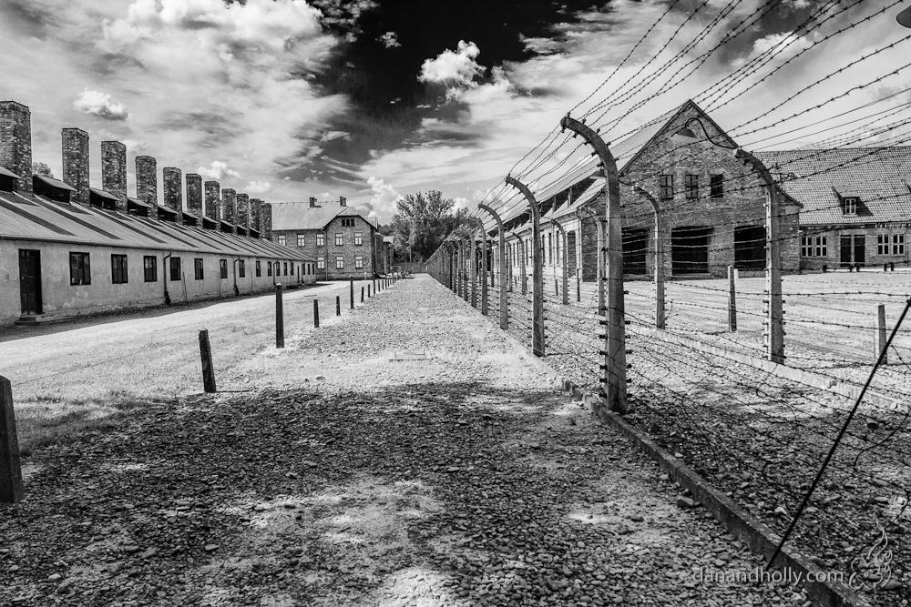
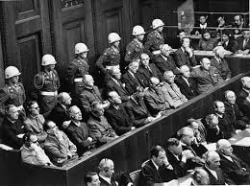
Friday March 11
20. Concentration Camps –prison camps in Nazi Germany and Poland
Nuremberg Trials –court proceedings held in Nuremberg, Germany after WWII where Nazi leaders were tried for aggression, violations of the rules of war, and crimes against humanity

