Slide 1
Vocabulary World War I
7-4.1 & 7-4.2

Slide 2
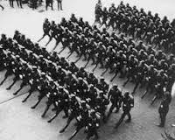
Thursday January 28
militarism –military power and glorification of war
Alliances –agreements among nations to aid each other if attacked

Slide 3
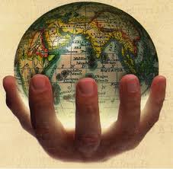
Thursday January 28
imperialism –nations taking control over other nations/caused economic rivalries
4. nationalism –countries having pride in their own countries and wanting power

Slide 4
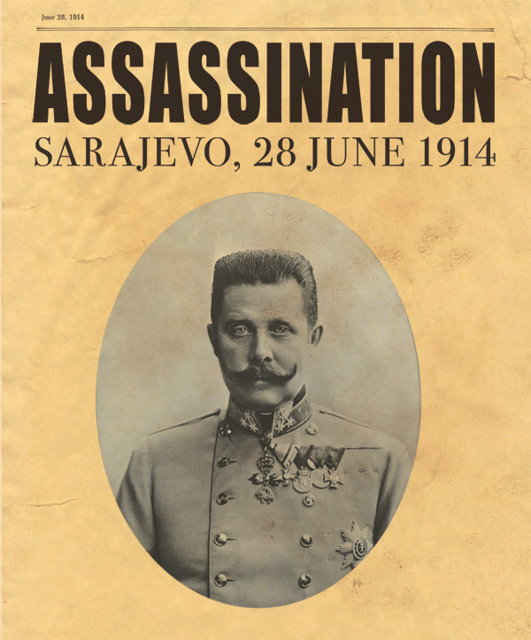
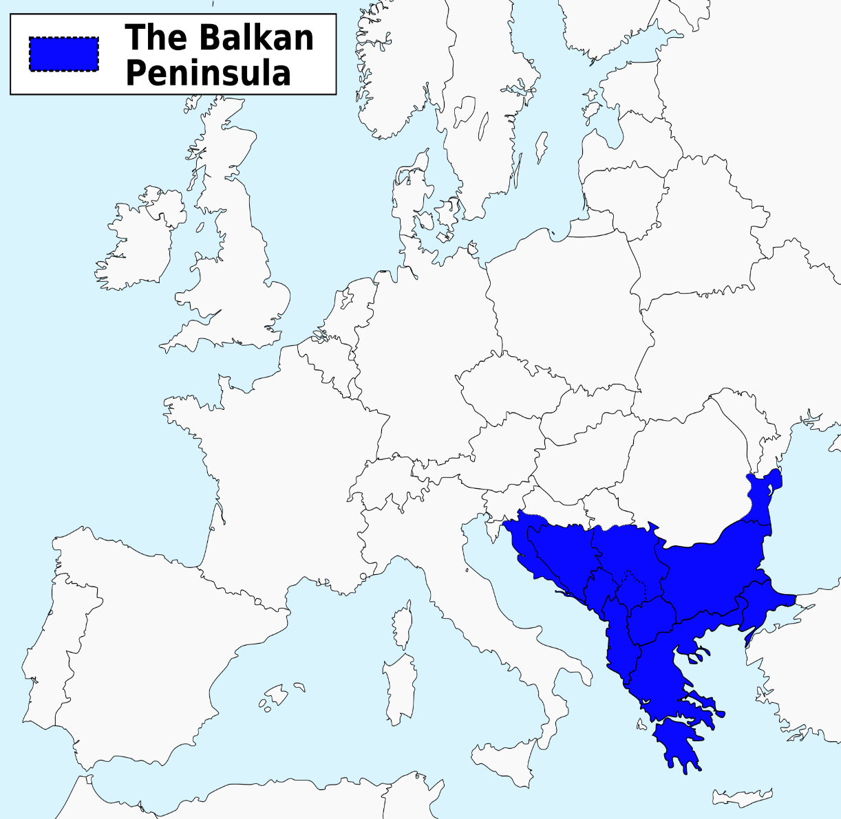
Tuesday, February 02
Archduke Franz Ferdinand –his assassination was the spark that started W.W.I.
Balkan peninsula –area in southern Europe known as the “powder keg of Europe.”

Slide 5
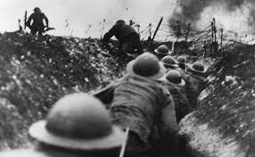
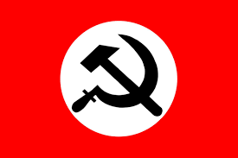
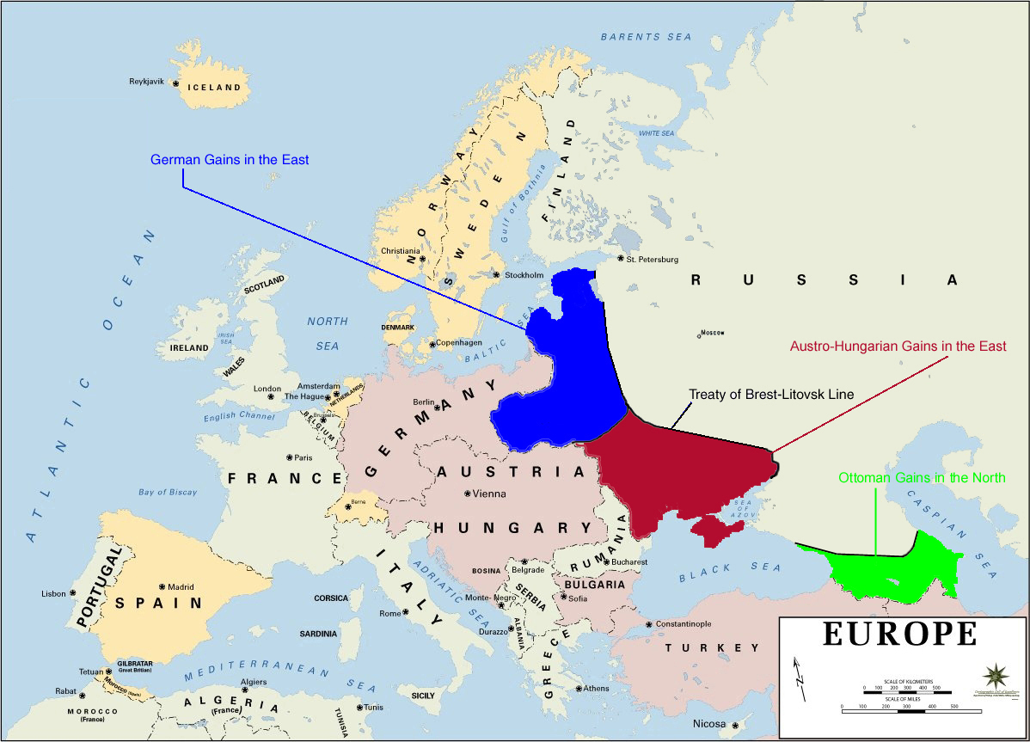
Tuesday, February 02
trench warfare –fighting from two opposing trenches(ditches)
Bolshevik Revolution(Russian Revolution) –working class revolted in Russia executing the Czar
The Treaty of Brest-Litovsk –Russia’s treaty with Germany to exit W.W.I.

Slide 6
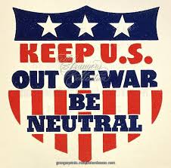
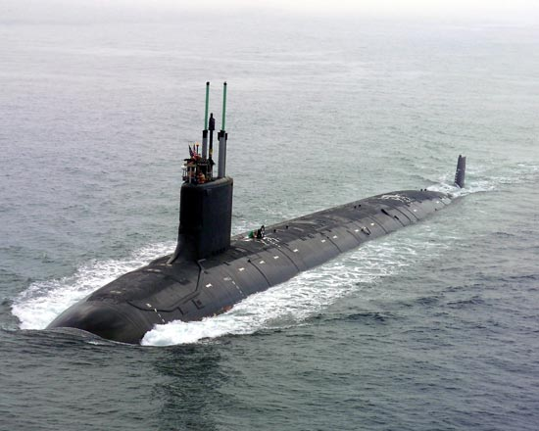
Wednesday February 3
neutral –not supporting either side in a conflict
Unrestricted submarine warfare – Germany’s policy of sinking any Allied ship with their U-boats

Slide 7
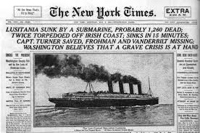
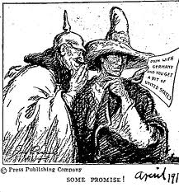
Wednesday February 3
Lusitania –British passenger ship that was sunk by German U-boat with American passengers on board
Zimmerman Telegram –German note that promised to give Mexico lands in America in exchange for attacking U.S.

Slide 8
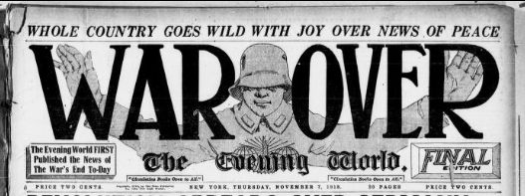
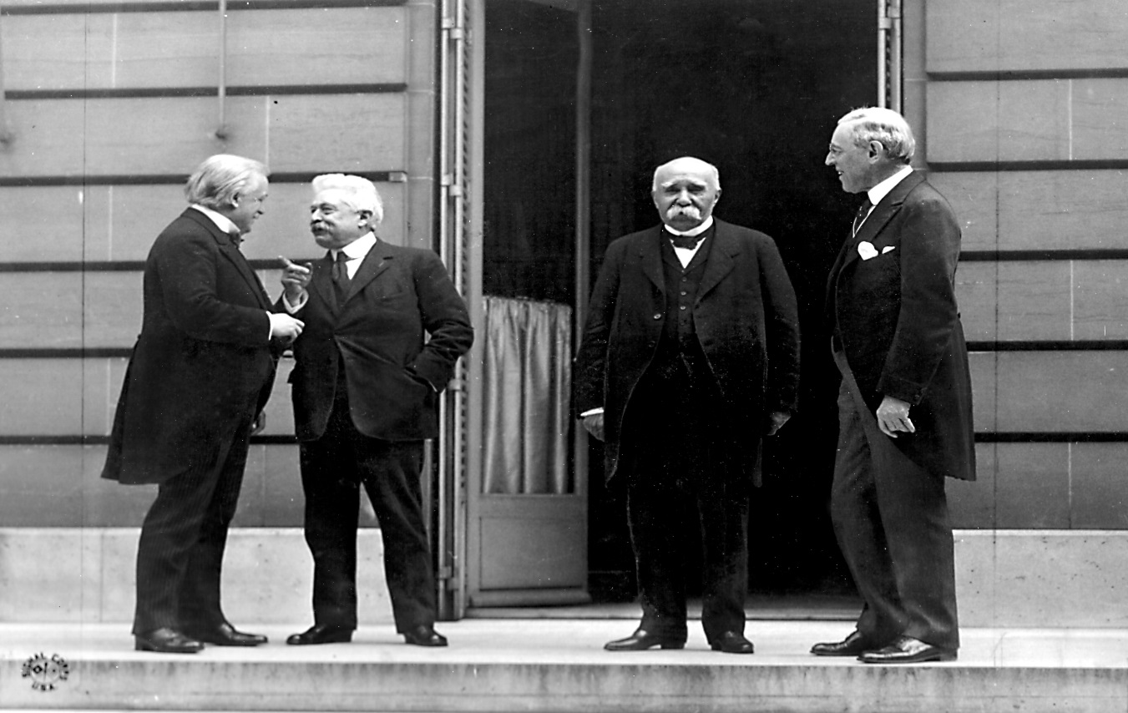
Friday February 12
armistice –cease-fire: November 11, 1918
Big Four –President Wilson(U.S.A.), Prime Minister David Lloyd George (Great Britain), Prime Minister Vittorio Orlando (Italy), & Prime Minister Georges Clemenceau (France)

Slide 9
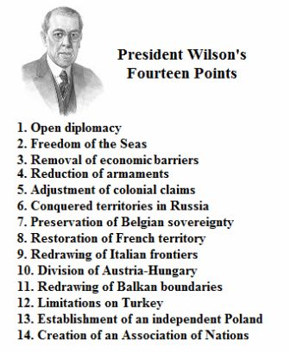
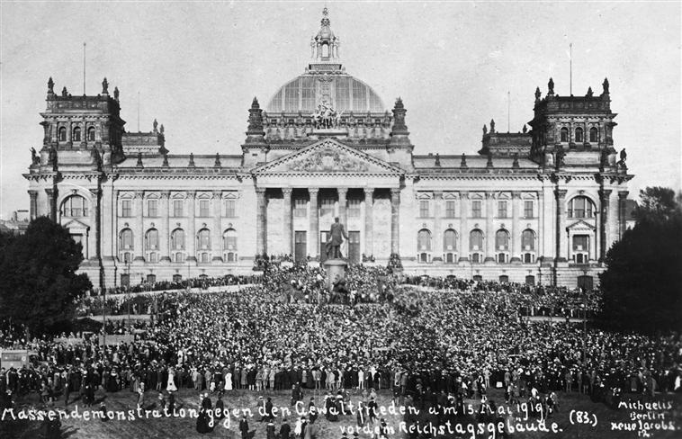
Thursday February 11
Fourteen Points –President Wilson’s plan for peace after W.W.I.
Treaty of Versailles –peace treaty of W.W.I. included: war guilt clause, reparations, no militarization of the Rhineland, and creation of the League of Nations

Slide 10
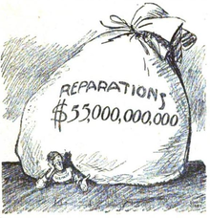
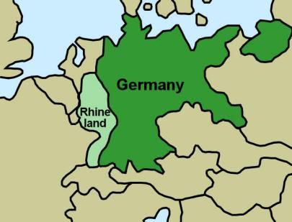
Thursday February 11
18. reparations - payment for war damages
Rhineland –buffer zone between France and Germany

Slide 11
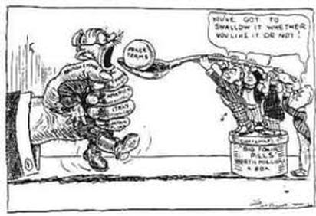
Thursday February 11
20. “War Guilt Clause”- Germany accepted responsibility for starting the war
21. League of Nations –the international peace keeping organization created after WWI

