Slide 1
United States and the Union of Soviet Socialist Republics and WWII

Slide 2
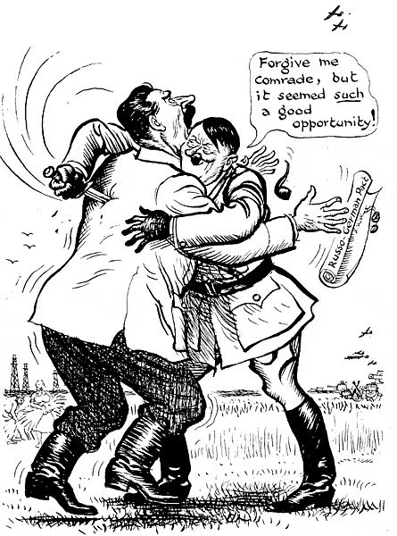
Germany Attacks USSR
German victories in the Balkans alarm Soviets
June 1941 Germany invades USSR
Britain and the US offer aid to USSR

Slide 3
Germany in the USSR
Germany had great success until they reach Moscow and Leningrad
Soviets used scorched-earth methods similar to the used by the Russians against Napoleon
Germany forced to retreat during harsh winter (…AGAIN…DUH…)

Slide 4
Battle of Stalingrad
Hitler makes the capture of Stalingrad the main objective of his offensive
Stalin orders Stalingrad to be held at all costs
August 1942-February 1943
Regarded as the single largest and bloodiest battle in history
Decisive Soviet victory

Slide 5
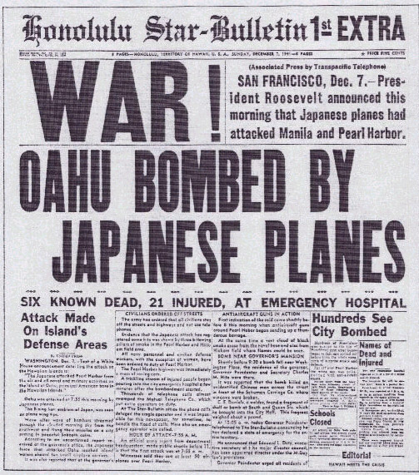
Japan in the Pacific
Japan uses European preoccupation with war to take Hong Kong, Singapore, Netherlands East Indies, and French Indochina
1940 alliance with Germany & Italy
1941 nonaggression treaty w/ USSR

Slide 6
Japan in the Pacific
US responds to Japan’s aggressions
Protests violations of the 9-Power Treaty of 1922
Gives assistance to Chinese nationalists
Embargo on sale of oil and scrap iron
Japan sees only threat to complete Pacific rule as American-held Philippines and Hawaiian Islands

Slide 7
“Awaken a Sleeping Giant”
Early 1941 Japanese leaders see US as most dangerous potential enemy
December 7, 1941 surprise attack on Pearl Harbor
Dec. 8 US/GB declare war on Japan
12/11 Germ/Italy declare war on US
US declares war on Germany/Italy

Slide 8
Vocabulary
Embargo
Scorched-earth method
Battle of Stalingrad
Nine-Power Act
“Awaken a sleeping giant”

