Slide 1
Triangular Trade

Slide 2
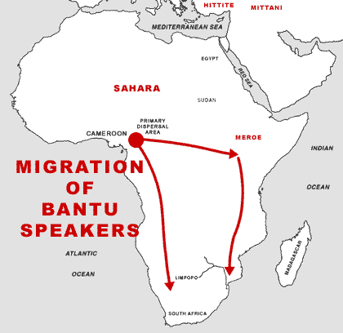
History of African Slavery
Slavery has existed since antiquity
It became common in Africa after the Bantu migrations spread agriculture to all parts of the continent (around 1500 BC)

Slide 3
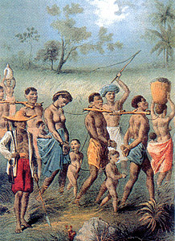
History of African Slavery
Most slaves in Africa were war captives
Once enslaved, an individual had no personal or civil rights
Owners could order slaves to do any kind of work, punish them, and sell them as chattel
Most slaves worked in agriculture

Slide 4
History of African Slavery
African law did not recognize individual land ownership so wealth and power in Africa came from not owning land but by controlling the human labor that made it productive
Slaves were a form of investment and a sign of wealth

Slide 5
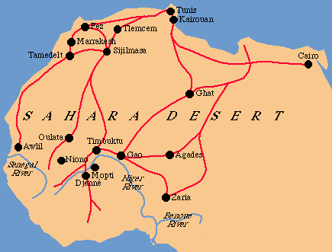
Islamic Slave Trade
After the 8th Century, Muslim merchants from north Africa, Arabia, and Persia sought African slaves for trade in the Mediterranean basin, southwest Asia, India, and as far away as southeast Asia and China
The Islamic slave trade lasted into the 20th Century and resulted in the deportation of as many as 10 million Africans

Slide 6
European Slave Trade
By the time Europeans arrived in Sub-Saharan Africa in the 15th and 16th Centuries, the slave trade was a well-established feature in African society
A detailed system for capturing, selling, and distributing slaves had been in place for over 500 years
With the arrival of the Europeans and the demand for slaves in the Americas, the slave trade expanded dramatically

Slide 7
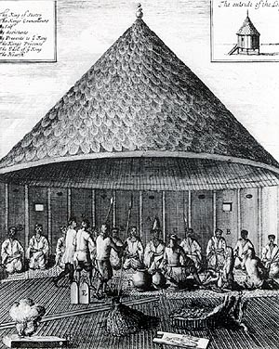
Portuguese Slave Traders
The Portuguese began capturing slaves in Africa in the 15th Century, but quickly learned it was easier to buy them
In Europe, slaves usually worked as miners, porters, or domestic servants since free peasants and serfs cultivated the land

Slide 8
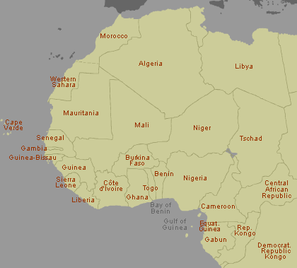
Portuguese Slave Trade
When the Portuguese discovered the Azores, Madeiras, Cape Verde Islands, and Sao Tome in the 15th Century they were all uninhabited; set up sugar plantations
The Portuguese population was too small to provide a large number of colonists
The sugar plantations required a large labor force
Slaves filled this demand
Cape Verde
Sao Tome

Slide 9
Slave Trade and Sugar
By the 1520s some 2,000 slaves per year were shipped to Sao Tome
Soon, Portuguese entrepreneurs extended the use of slave labor to South America
Eventually Brazil would become the wealthiest of the sugar-producing lands in the western hemisphere

Slide 10
Slavery Expands
As disease reduced the native populations in Spanish conquered territories, the Spanish began relying on imported slaves from Africa
In 1518, the first shipment of slaves went directly from west Africa to the Caribbean where the slaves worked on sugar plantations
By the 1520s, the Spanish had introduced slaves to Mexico, Peru, and Central America where they worked as cultivators and miners
By the early 17th Century, the British had introduced slaves to North America

Slide 11
Triangular Trade
The demand for labor in the western hemisphere stimulated a profitable three-legged trading pattern
European manufactured goods, namely cloth and metal wares, especially firearms, went to Africa where they were exchanged for slaves
The slaves were then shipped to the Caribbean and Americas where they were sold for cash or sometimes bartered for sugar or molasses
Then the ships returned to Europe loaded with American products

Slide 12
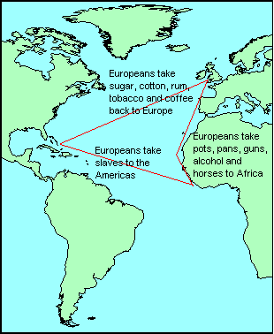
Typical Triangular Trade Route

