Slide 1
The Reformation

Slide 2
Early Causes/Discontent
Northern Renaissance writers study early Christian period and Greek/Roman classics
Erasmus argued for a more simpler, original church that he said Jesus proclaimed
Political clashes between the Papacy and northern European states

Slide 3
Northern Humanists
Claimed church had lost sight of spiritual mission
Unhappy with Pope’s involvement in politics
Resented papal taxes
Criticized fasting and pilgrimages
Believed the practice of selling indulgences was immoral and not necessary for the followers

Slide 4
Early Problems for the Church
Babylonian Captivity (1309-1377)-Pope Clement V moves church headquarters to Avignon, France; many feel pope is under French control during this time; 7 popes all Fr.
Great Schism (1378-1417)-more than one pope elected, political support for differing popes

Slide 5
Selling Indulgences
Practice of the church rewarding a person for pious acts, such as participation in the Crusades or helping the poor
Post-Crusades church began selling indulgences to raise money for St Peter’s Basilica in Rome and other debts
Church starts selling indulgences just to raise money, leads to abuse by sellers
Johann Tetzel-monk sent to German states to sell; very profitable, shares money with rulers

Slide 6
Jon Wycliffe
The 14th-century English reformer John Wycliffe boldly attacked the papacy itself, striking at the sale of indulgences, pilgrimages, the excessive veneration of saints, and the moral and intellectual standards of ordained priests.
To reach the common people, he translated the Bible into English and delivered sermons in English, rather than Latin.

Slide 7
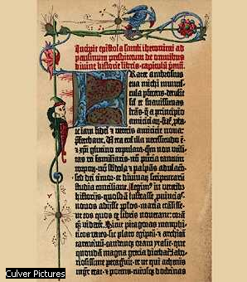
Johannes Gutenberg
The Gutenberg Bible: first book known to have been created with movable metal type.
Printed by Johannes Gutenberg in Mainz, Germany, between 1450 and 1455
Advent of movable type increased the efficiency of printing and the number of books that could be produced. More books and a more literate population, in turn, enhanced the spread of ideas throughout Europe, fueling the 16th-century Protestant Reformation in Germany.

Slide 8
What was the Protestant Reformation?
Prior to the Reformation all Christians were Roman Catholic
The [REFORM]ation was an attempt to REFORM the Catholic Church
People like Martin Luther wanted to get rid of the corruption and restore the people’s faith in the church

Slide 9
What was the Protestant Reformation?
CHRISTIANITY
CATHOLIC
PROTESTANT

Slide 10
Calls for Reform
John Wycliffe (1330-1384)-English priest/teacher
  Questioned the authority of the pope; people should read Bible for themselves, translated Bible into English
Jan Hus (1370-1415)-Czech priest/teacher
  Follower of Wycliffe, criticized the vast wealth of the Church, declared a heretic, burned at the stake
Desiderius Erasmus (1469-1536)-Dutch priest/humanist
  Attacked corruption in the Church, called the “Father of the Reformation”
Huldrych Zwingli (1484-1531)-Swiss priest
  Called for reforms to sacraments (fasting, marriage, etc.), influenced first by Erasmus, later by Luther

Slide 11
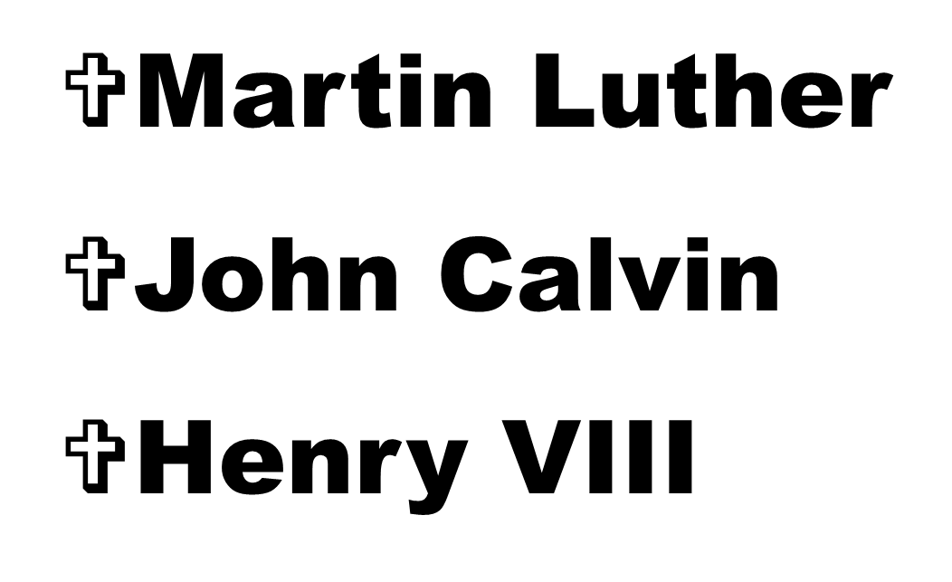
The Reformers

Slide 12
Martin Luther
Lived from 1483-1546 in Germany
Father encouraged him to study law
A sudden religious experience inspired him to become a monk and teacher

Slide 13
Martin Luther
In the monastery he observed the rules imposed on a novice but did not find the peace in God he had expected.
Became a monk in 1506, and his superiors selected him for the priesthood.
Ordained in 1507. After his ordination, Luther was asked to study theology in order to become a professor at one of the many new German universities staffed by monks.

Slide 14
Martin Luther
In November 1510 made a visit to Rome, where he performed the religious duties customary for a pious visitor
Shocked by the worldliness of the Roman clergy.
Begins to question papal authority.

Slide 15
Ninety-Five Theses
Luther became a public and controversial figure when he published (October 31, 1517) his Ninety-Five Theses by nailing it to the Wittenberg Chapel door.
Includes propositions opposing the manner in which indulgences were being sold in order to raise money for the building of Saint Peter's in Rome, questing the wealth of the church, questioning the power of the pope

Slide 16
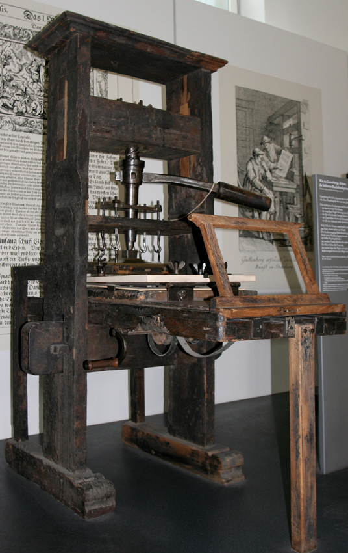
Luther’s Ideas
Luther’s ideas spread quickly with the help of the printing press.
Luther’s supporters distributed copies of his speeches and essays far and wide.
Millions of people sided with Luther against the Roman Catholic Church.

Slide 17
Reaction to 95 Theses
Summoned to appear before Emperor Charles V at the Diet of Worms in April 1521
He was asked before the assembled secular and ecclesiastical rulers to recant. He refused firmly, asserting that he would have to be convinced by Scripture and clear reason.
Luther is excommunicated January 1521.
Goes into hiding, translates Bible into German

Slide 18
Lutheranism
Luther soon had many followers.
His supporters began to organize a new Christian denomination.
Several German princes supported Luther.
Lutherans and Catholics fought each other.
The first wars ended with the Treaty of Augsburg, but fighting in Europe over religion continued to the mid-seventeenth century.

Slide 19
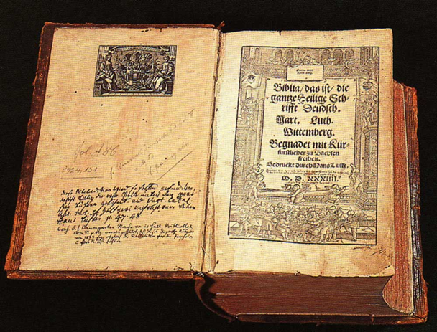
Lutheranism
Luther’s followers disagreed with many of the teachings of the Catholic Church.
They rejected the authority of Church councils and the pope.
Reading the Bible was the only way to learn how to lead a good life.

Slide 20
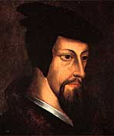
John Calvin
1509-1564
Anti-Catholic
Influenced by Martin Luther
Disagreed with Luther’s “Salvation through faith alone.”
Created his own Protestant religion in Switzerland

Slide 21
Calvin’s Ideas
  Salvation through Predestination
    At birth it is decided if you will go to heaven or hell, “the Elect”
  Foreknowledge
    God knows everything that will happen in your life
  Purified approach to life:
    No drinking, swearing, card playing, gambling etc..

Slide 22
Calvinism
Becomes a theocracy in Geneva (Switzerland)
Other Calvinist denominations
  England = Puritans
  Scotland = Presbyterians-John Knox
  Holland = Dutch Reform
  France = Huguenots
  Germany = Reform Church

Slide 23
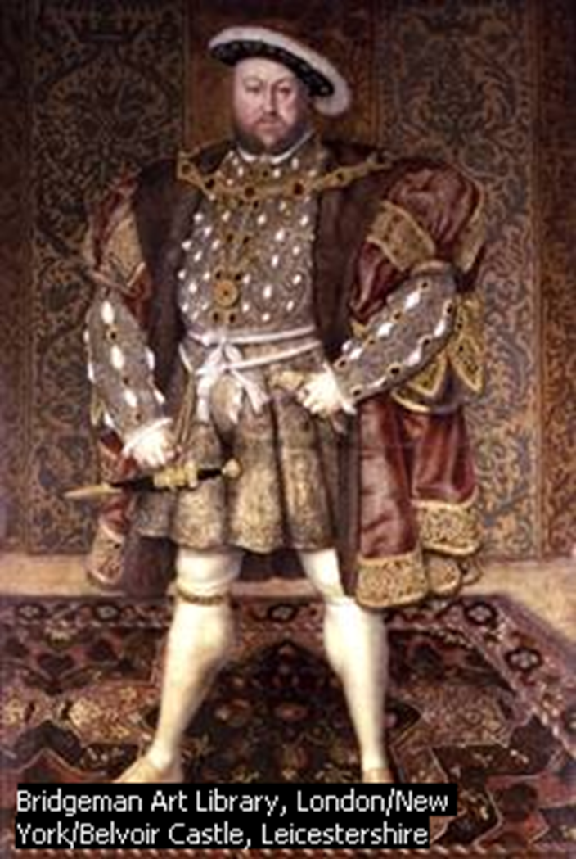
Henry VIII
Defended Catholic Church against Luther
Given title of “Defender of the Faith”
Six wives (2 were beheaded)
Leader of the Church of England (Anglican)

Slide 24
Henry VIII
First wife: Catherine of Aragon
After she could only bear Henry a daughter, he decided to divorce her
Asked Pope Clement VII for an annulment; pope refuses
Henry VIII asks Parliament to create a new church, it does
England removes itself from the Catholic Church, claims all lands and monies for the crown

Slide 25
Catholic=Christianity
Catholic
Protestant
Lutheran
Calvinism
Anglican
Presbyterian
Puritan
Hugeunots

