Slide 1
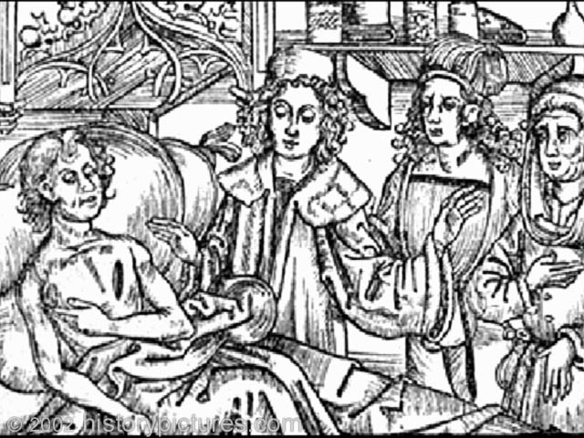
Black Death - The Plague
Notes:
During the late Middle Ages and early Renaissance, the bubonic plague—commonly referred to as the “Black Death”—ravaged the population of Europe. It was transmitted to humans by fleas that had bitten infected rats. The disease caused very painful swollen lymph nodes called buboes. The name “Black Death” came from the dried blood which would often form under the skin and cause black spots.

Slide 2
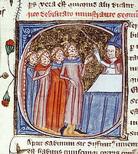
Plague/Black Death:
1/3 of population wiped out
Defining event(s) of the Middle Ages
Spread by fleas which lived on rats
A lack of cleanliness added to their vulnerability: crowded with poor sanitation; ate stale or diseased meat; primitive medicine (people were often advised to not bathe b/c open skin pores might let in the disease).
Highly contagious disease nodules would burst around the area of the flea bite.
In 1347, Italian merchant ships returned from the Black Sea, one of the links along the trade route between Europe and China. Many of the sailors were already dying of the plague, and within days the disease had spread from the port cities to the surrounding countryside. The disease spread as far as England within a year.

Slide 3
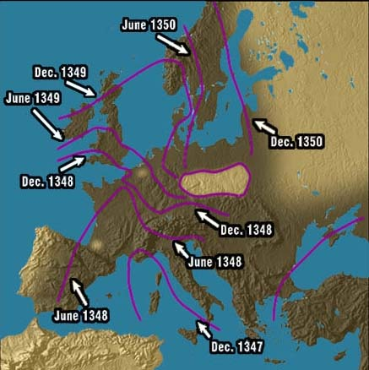
Spread of the Plague
Started in China
Reached Europe in 1347 via a merchant ship on the island of Sicily
1347–48: southern Europe
1349–50: central Europe and the British Isles
Notes:
The plague started in China and killed millions of people in mainland Asia. Due to its highly communicable nature, it spread very quickly. It first reached Europe in Sicily in 1347, when a merchant ship returning from China landed carrying rats with infected fleas. Trade and travel helped spread the plague to mainland Europe. By 1348, it had ravaged southern Europe. By 1350, it had hit central Europe and the British Isles. The plague spread for several reasons, including the outbreak of war (the Hundred Years’ War was fought while the plague affected Europe) and the fact that many infected people often brought the disease to new locations by trying to escape the horrors of the disease.

Slide 4
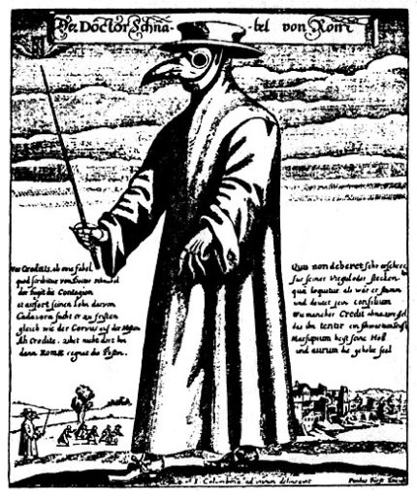
Popular Medical “Cures” for the Plague
Doctors wore strange costumes
Bathing in human urine
Wearing excrement
Placing dead animals in homes
Wearing leeches
Drinking molten gold and powdered emeralds
Burning incense to get rid of the smell of the dead
A costume worn by doctors to ward off the Plague
Notes:
At the time, the field of medicine did not understand what caused the Black Death—or how to cure it. Doctors wore strange costumes and used folk cures to deal with the disease. Among the more absurd remedies:
Bathing in human urine
Wearing excrement
Placing dead animals in homes
Wearing leeches
Drinking molten gold and powdered emeralds
Burning incense to get rid of the smell of the dead
Not surprisingly, these “cures” did little to address the real problems of the plague and many even made the disease worse.

Slide 5
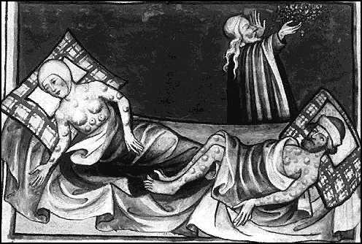
Effects of the Plague
Killed 25–35 million Europeans
Undermined faith in religion
Economy
Culture influenced
Notes:
The most obvious effect of the plague was the number of people it killed—an estimated 25 to 30 million Europeans, or roughly one-third of the population. The plague also shook many people’s faith in religion. Though many religious leaders blamed the plague on sin, piety and prayer offered no protection against the disease and members of the clergy were as likely to become afflicted as anyone else. In the face of all this, the numbers of those willing to devote their life to the church dramatically declined.
The population decrease caused by the plague led to an economic downturn; both the number of available laborers and consumers declined sharply. Merchants and tradespeople had fewer people to whom they could sell their wares. Products therefore accumulated, and the merchants and those who dealt with them—bankers, suppliers, and shippers—all lost revenue. In addition, peasants often left their land in an attempt to escape the disease.
The plague also influenced many of the artists of the time; works from this period often had very dark themes and tones.

