Slide 1
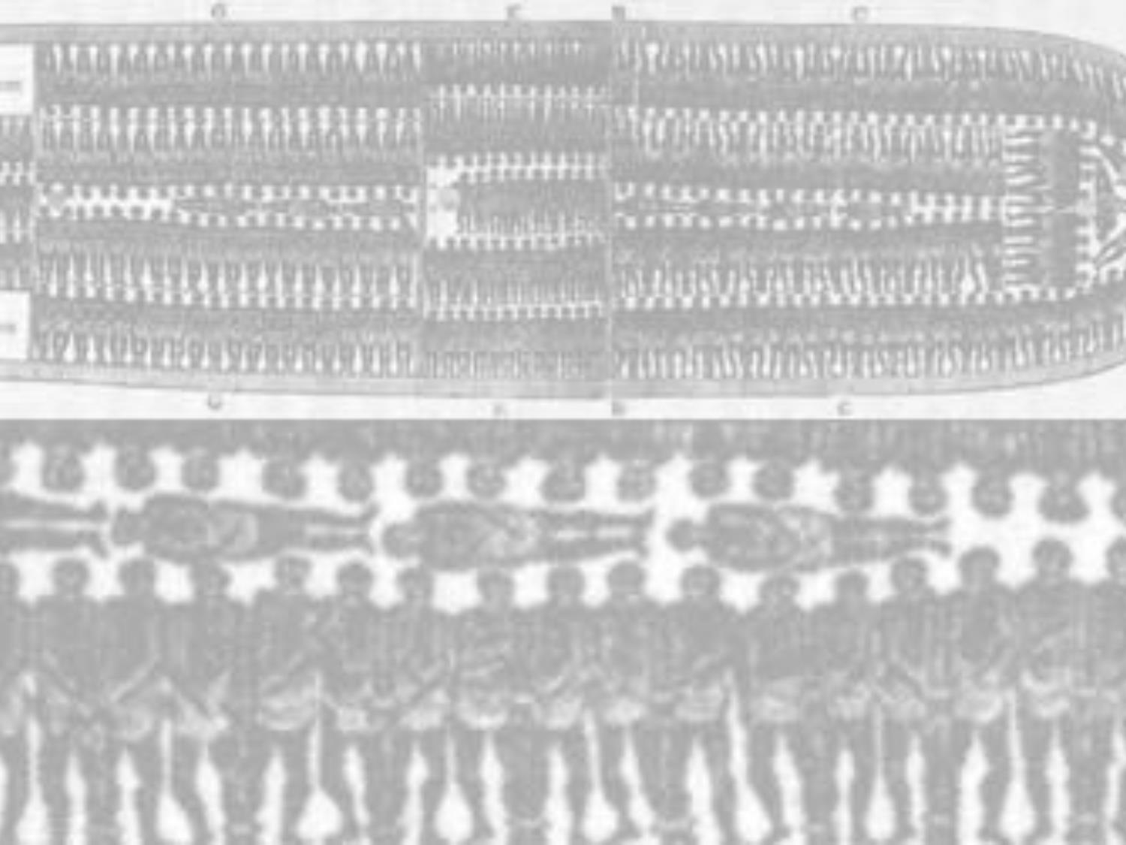
The Middle Passage

Slide 2
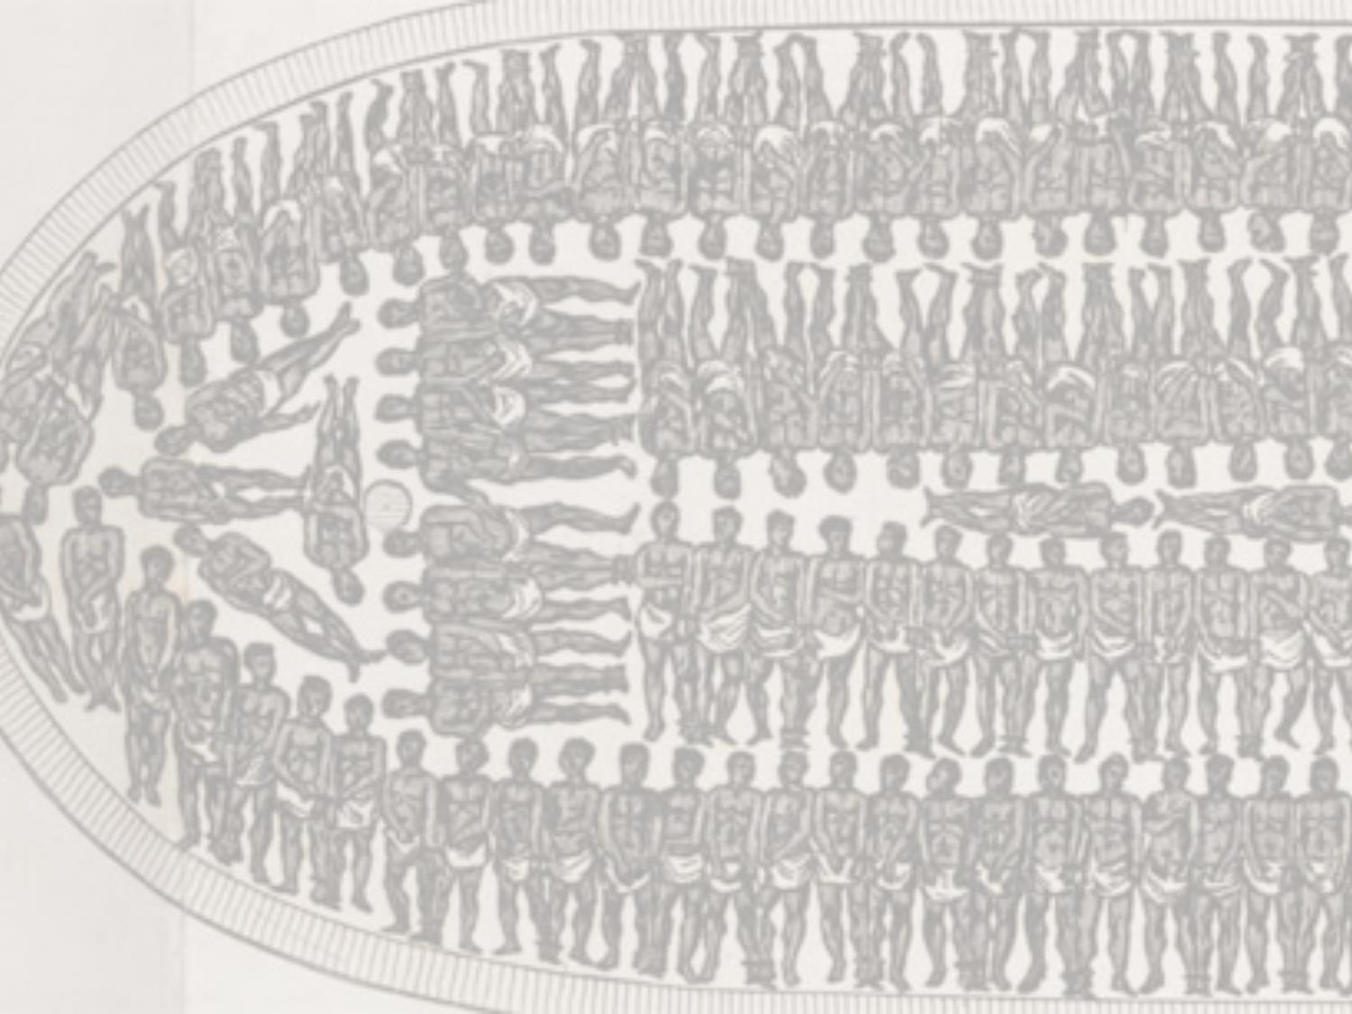
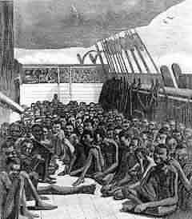
Middle Passage
Following capture, slaves were force-marched to holding pens on or near the coast before being loaded on ships
The trans-Atlantic journey was called the “Middle Passage”
The ships were filthy, hot, and crowded, designed for carrying a maximum number of slaves

Slide 3
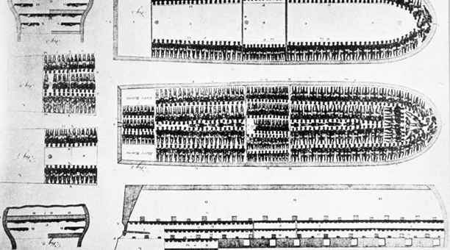
Middle Passage
Most ships provided slaves with enough room to sit upright, but not enough to stand
Usually slaves forced to lie in chains with barely 20 inches space between them, or often with their heads between the legs of others, in human waste and blood

Slide 4
Middle Passage
Crews wanted as many slaves alive as possible to maximize profits, but treatment was extremely cruel
Some slaves refused to eat-crew members used tools to pry open their mouths and force-feed them
Sick slaves tossed overboard to prevent infection from spreading
Ship captains consulted special books advising on the most profitable method of packing slaves below deck in their cargo holds
During the early days of the slave trade, mortality rates were as high as 50%
As the volume of trade increased/conditions improved (bigger ships, more water, better nourishment and facilities), mortality eventually declined to about 5%

Slide 5
Middle Passage
The time a ship took to make the Middle Passage depended upon several factors including its point of origin in Africa, the destination in the Americas, and conditions at sea such as winds, currents, and storms. Some voyages could last as long as 4 months.
With good conditions and few delays, a 17th-century Portuguese slave ship typically took 30 to 50 days to sail from Angola to Brazil.
British, French, and Dutch ships transporting slaves between Guinea and their Caribbean island possessions took 60 to 90 days.
As larger merchant ships were introduced, these times reduced somewhat
Approximately 54,000 voyages took place

Slide 6
Volume of the Slave Trade
Late 15th and 16th Century… 2,000 Africans were exported each year
17th Century… 20,000 per year
18th Century… 55,000 per year
1780s… 88,000 per year
All told, some 12 million Africans were transported to the western hemisphere via the Atlantic Slave Trade
Another 4 million died resisting capture or during captivity before arriving at their destination

Slide 7
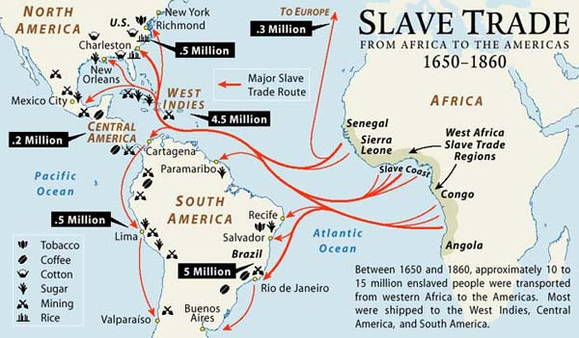

Slide 8
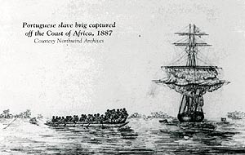
Slavery Continues
Abolishing the slave trade did not end slavery
British ships patrolled the west coast of Africa to halt illegal trade
The last documented ship that carried slaves across the Atlantic arrived in Cuba in 1867

Slide 9
Timeline for Abolition of Slavery
1854: Slavery abolished in Peru and Venezuela.
1863: Emancipation Proclamation issued in the U.S.
1863: Slavery abolished in all Dutch colonies.
1865: Slavery abolished in the U.S. as a result of the Thirteenth Amendment to the Constitution and the end of the Civil War.
1871: Gradual emancipation initiated in Brazil.
1873: Slavery abolished in Puerto Rico.
1886: Slavery abolished in Cuba.
1888: Slavery abolished in Brazil.
1960s: Slavery abolished in Saudi Arabia and Angola

Slide 10
African Diaspora
Obviously, the main contribution slaves brought to the western hemisphere was an incredible amount of labor, without which the prosperous new societies could not have developed
However they brought other contributions as well:
Slaves built hybrid cultural traditions made up of African, European, and American elements
Influenced language by creating tongues that drew on several African and European languages

Slide 11
Gullah
For several reasons, Africans, both as slaves and free, enjoyed a relative amount of self-sufficiency in the Sea Islands off of South Carolina
Their culture maintained much of its original characteristics as it encountered American culture
For example, most of the Gullah vocabulary is of English origin, but the grammar and major elements of pronunciation come from a number of West African languages
Language still spoken in the Lowcountry of South Carolina
Taught at the University of South Carolina

