Slide 1
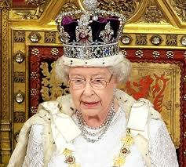
The English Monarchy

Slide 2
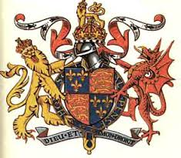
The House of Tudor
Late 1400s the Tudors come into power in England
Tried to increase power in the style of other European absolutists
Henry VII – first Tudor king, increased wealth and stability
Henry VIII – Anglican Church
Edward VI – six years, sickly

Slide 3
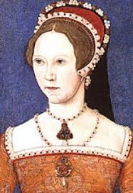
Mary I
Oldest daughter of Henry VIII
First reigning queen of England
Catholic, tried to destroy Anglican Church
“Bloody Mary” – had more than 300 people burned at the stake
Efforts to rid England of protestants led to rebellions

Slide 4
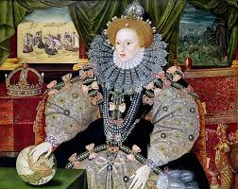
Elizabeth I
Mary I dies 1558, half-sister Elizabeth I (Tudor House) becomes queen
Worked with Parliament to strengthen Protestantism (Elizabeth is Protestant)
Mary Queen of Scots
Elizabeth’s first cousin
Queen of Scotland
Flees to England escaping rebellion
Plots with Philip II (Spain) to seize English crown, Elizabeth finds out, beheads Mary

Slide 5
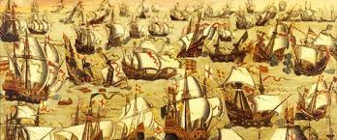
Spanish Armada
1588 Philip II launches Spanish Armada
151 ships
8000 sailors
18, 000 soldiers
Spain is defeated
English national pride soared
Elizabeth’s popularity increases

Slide 6
Troubles at Home - Religion
Puritans wanted to further “purify” the Anglican church after its break with the Catholic Church
Elizabeth refuses to change the Anglican Church; fines non-Anglican Protestants; persecutes Catholics

Slide 7
Elizabeth I and Parliament
Parliament
House of Lords: nobility and clergy
House of Commons: gentry-landowners without titles, burgesses-merchants and professionals from the cities and towns
Elizabeth allowed Parliament to debate; she asked for their advice on issues of state
Was able to get things passed that she needed such as new taxes

Slide 8
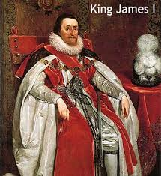
James I
Elizabeth I dies in 1603; never married, no heir
King James VI of Scotland-son of Mary Queen of Scots (Stuart House): becomes king
Unites England and Scotland
Strong supporter of Anglican Church-puts him at odds with the Puritans; authorizes new translation of the Bible: The King James Version
Believer in the “Divine Right of Kings”-puts him at odds with the House of Commons

Slide 9
James I and Parliament
Puritans have a strong membership in Parliament; oppose James’s plans
Can’t get Parliament to agree to new taxes; sells titles of nobility, raises customs duties, and grants monopoly rights to raise money
Parliament disagrees with James’ attempts to ally with Spain; forces another war with Spain
James I dies 1625; son Charles I takes throne

