Slide 1
The Congress of Vienna

Slide 2
The Congress of Vienna
Treaty of Paris signed May 30, 1814
Established peace between Fr. and Russia, Prussia, GB, Austria, Portugal, Sweden and Spain
Also provided for a subsequent meeting to hash out differences
Conference of ambassadors of European states
Headed by Austrian Klemens Wenzel von Metternich
September 1814 to June 1815

Slide 3
The Congress of Vienna Representatives
Great Powers:
Austria led by Metternich
Russia led by Czar Alexander I
Prussia led by Prince Karl von Hardenberg
Great Britain led by the Duke of Wellington (left to fight Napoleon at Waterloo)
Other Treaty of Paris signatories:
Sweden
Portugal
Spain (joined after 1 month)
France (invited two months into conference)

Slide 4
The Congress of Vienna Other Participants
More than 200 states and princely houses were represented, including Denmark, Netherlands, Papal States, and Switzerland
Other special interest groups were represented such as religious organizations, special interest groups (German publishers), corporations, etc.

Slide 5
The Congress of Vienna Guiding Principles
Europe must live under a balance of power; no one nation should become too powerful
European countries that were damaged the greatest by France and Napoleon were to be repaid for what they lost
Decisions to follow Legitimacy: former ruling families would be restored where possible

Slide 6
The Congress of Vienna Goals
Main goal: to provide a long term peace fro all of Europe after the French Revolution and Napoleonic Wars
Goal to “resize” main European powers so they would balance each other
Goal to right the wrongs committed particularly by France during the wars of the last twenty years

Slide 7
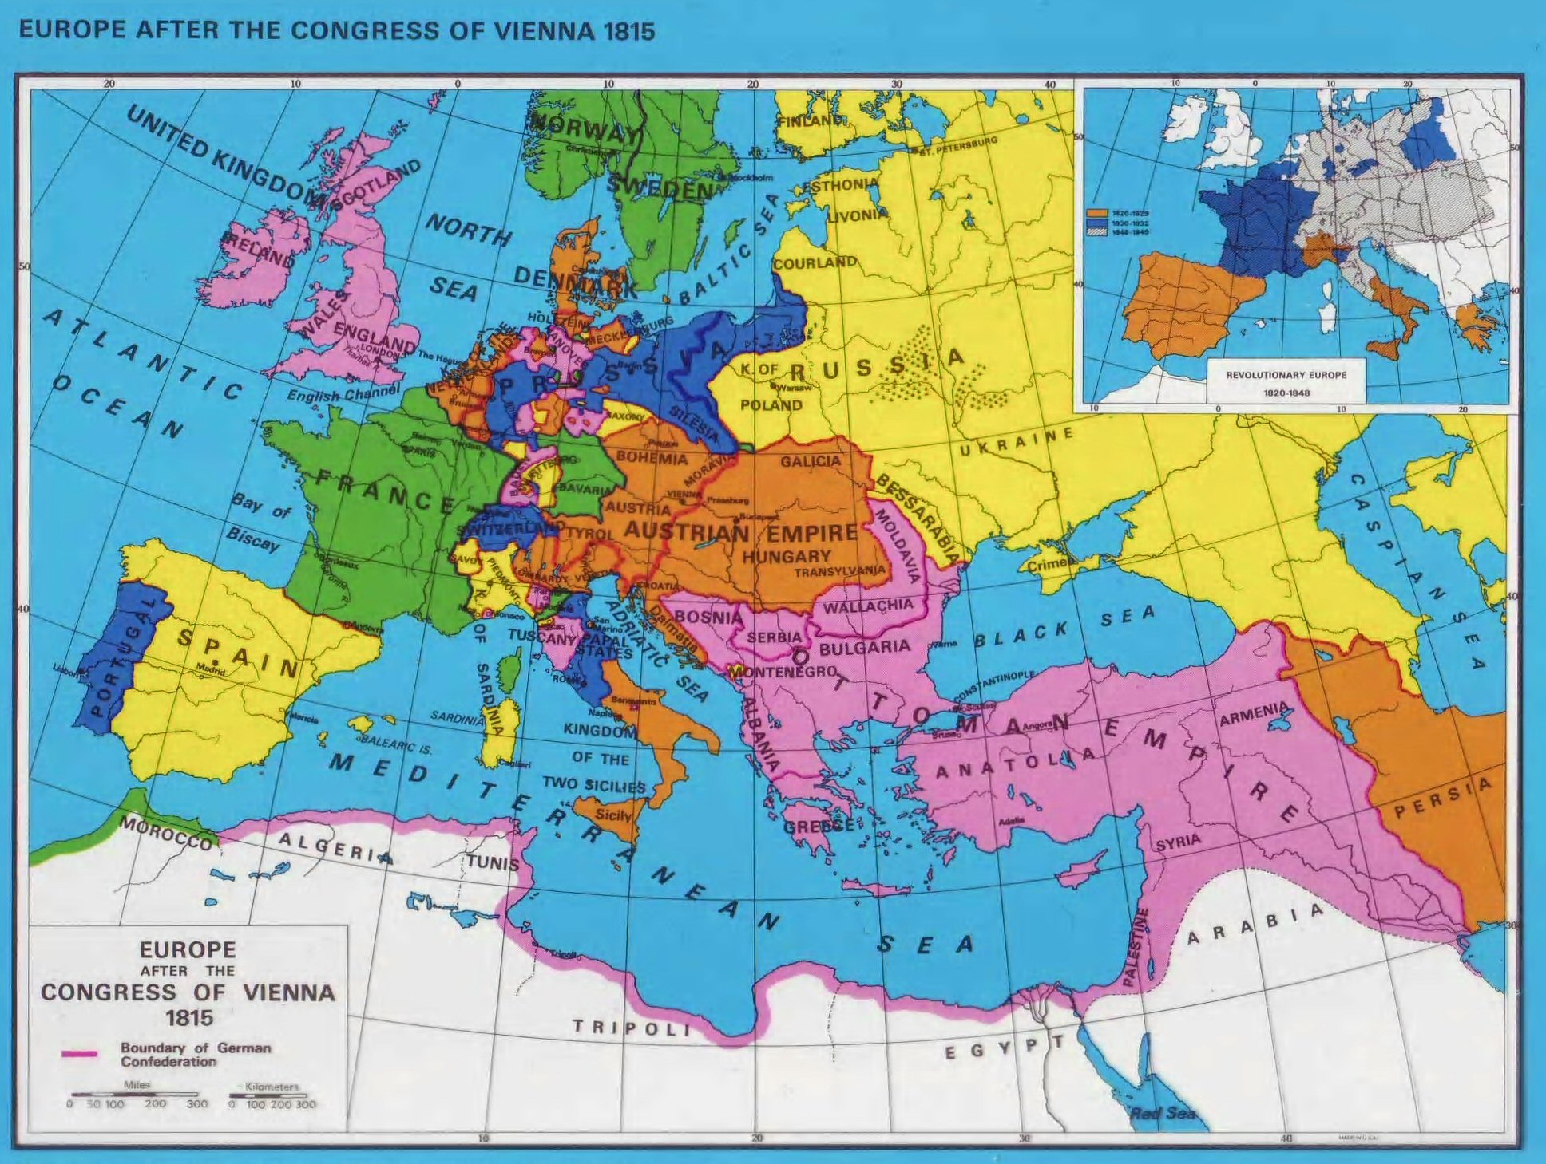

Slide 8
The Congress of Vienna Major Territorial Realignments
The Papal States revert to the Pope
Russia given Poland and allowed to keep Finland
Prussia given territories along Rhine River
France’s boundaries returned to pre-1790

Slide 9
The Congress of Vienna Major Territorial Realignments
Netherlands and Southern (Austrian) Netherlands (Belgium) united in a constitutional monarchy
German Confederation created out of the states of the HRE, under the presidency of the Austrian Emperor; Austria gained northern Italian states
Sweden gained Norway (punishes Denmark for helping Napoleon)

Slide 10
The Congress of Vienna Other Decisions
Switzerland was given a new constitution and its future neutrality was guaranteed
Many small duchies and kingdoms restored and expanded
Agreed to the free navigation of international rivers such as the Rhine and Danube

Slide 11
The Congress of Vienna Other Decisions
Abolished the slave trade for all of Europe
Set a model for the League of Nations (1919) and the United Nations (1945)
France required to pay indemnity: a financial reward to the countries that had been damaged (700 million francs + actual damages)
Coalition forces to occupy France for 3-5 years

Slide 12
The Congress of Vienna Later Criticisms
Ignored the Enlightened ideals of nationalism and liberties that are spreading through Europe
De-emphasized the civil rights associated with the French and American Revolutions
Not all countries were allowed to actively participate
Italian peninsula divided into seven parts under different powers
Poland remained partitioned

