Slide 1
Spanish Empire

Slide 2
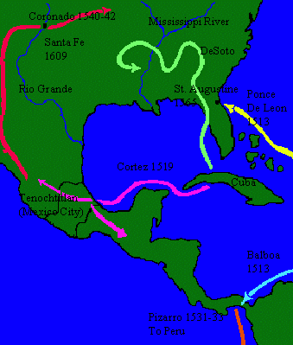
Conquistadores
Spanish realized there were no spices or silk in the Caribbean; turned attention to the American mainland, west into Mexico and south into Panama and Peru
Hernan Cortes
Francisco Pizarro
Ponce de Leon
Hernando de Soto

Slide 3
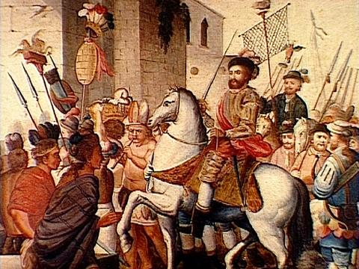
Cortes
In 1519, Cortes arrived in Mexico looking for gold with about 450 soldiers
He advanced inland to the Aztec capital of Tenochtitlan, captured Motecuzoma II, and starved Tenochtitlan into surrender in 1521

Slide 4
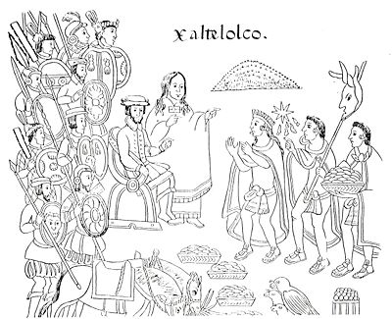
Cortes
Cortes had obvious advantages in terms of weaponry, divisions among the indigenous people of Mexico, and the intelligence, diplomatic, and linguistic help of Dona Maria (a Mayan woman who accompanied him), but his conquest of Tenochtitlan (population of about 200,000) with less than 500 soldiers was aided immensely by the smallpox epidemic

Slide 5
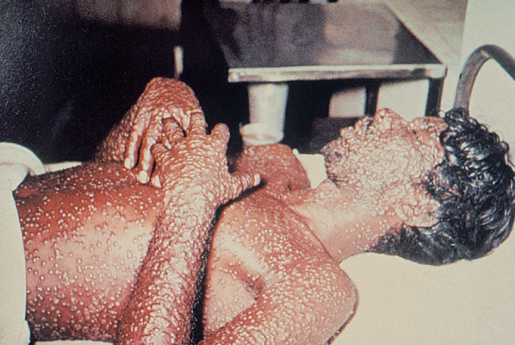

Slide 6
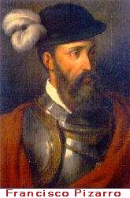
Pizarro
In 1530, Francisco Pizarro led a Spanish expedition from Central America to Peru
Started out with 180 soldiers, but later received reinforcements to make a force of about 600
Captured the Inca capital of Cuzco in 1533, murdering Atahualpa and other ruling elites and extorting and stealing gold
By 1540, the Spanish had secured Peru

Slide 7
Comparison: Pizarro - Atahualpa
Spaniards
168 soldiers
Steel swords
Steel armor
Guns
Horses
Incas
80,000 soldiers
Stone, bronze or wooden clubs, maces, and hand axes
Quilted armor
Slingshots
No animals on which to ride into battle

Slide 8
Reasons for Cortes’/Pizarro’s Success
Military technology based on guns, steel weapons, and horses
Infectious diseases endemic in Eurasia
European maritime technology

Slide 9
Reasons for Cortes’/Pizarro’s Success
Military technology based on guns, steel weapons, and horses
Guns played a relatively minor role. Pizarro had only a dozen of them.
More important were horses which provided shock, speed, maneuverability, and a protected fighting platform that left foot soldiers nearly helpless in the open.
The Spaniard’s steel armor protected them against the Inca’s club blows, while the Inca’s quilted armor offered no protection against steel weapons.

Slide 10
Reasons for Cortes’/Pizarro’s Success
Infectious diseases endemic in Eurasia
Throughout the Americas, diseases introduced by Europeans spread in advance of the Europeans themselves, killing an estimated 80-95% of the pre-Columbian Native American population
European maritime technology
It was maritime technology that allowed Conquistadores to come to the New World, rather than the other way around

Slide 11
Reasons for Cortes’/Pizarro’s Success
Centralized political organization of European states
Spain’s Government financed, staffed, and equipped expeditions to the New World.
The Aztecs and Incas also were centralized, but the bureaucracy so strongly identified with its godlike monarchs, it easily fell apart in war
Additionally many subjects despised the Aztec and Incan rulers as overlords and tax collectors so in many cases resistance was light

Slide 12
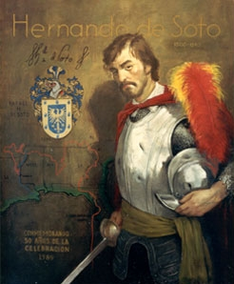
Hernan de Soto
Hernando de Soto was with Pizarro in Peru; went on to explore South Carolina, Georgia, Florida, Alabama, Mississippi, and Arkansas
In 1541, he “discovered” the Mississippi River

Slide 13
Ponce de Leon
Named governor of Puerto Rico, 1509
Led expedition to Florida, which he named in 1513
Also explored Bahamas, Cuba, and the Florida Keys

Slide 14
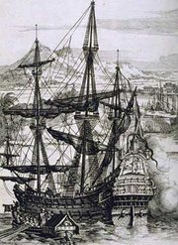
Spanish Trading Post Empire: Philippines
The Spanish arrived in the Philippines in 1565, controlled most of the coastal regions by 1575, and controlled most of the archipelago during the 17th Century
Spanish activities revolved around trade and Christianity
(Today the Philippines are 83% Roman Catholic)
The most prominent area was the port of Manila which supported the trade of silk from China with New World silver from Mexico
“Manila galleons” transported cargo from the Philippines to Mexico

Slide 15
Spanish Decline
Growing population in Spain
Need for more food, housing, clothes
Shortages appear in these goods
Influx of gold and silver into country
“new” drives up prices
Spiraling inflation
Decreased demand for Spanish-made products

Slide 16
Spanish Decline
Lack of capable middle class
Spanish nobles prefer military
Jews and Moors expelled from country
Much of the incoming wealth used to by goods from other countries
Citizenry becomes discontent-high inflation, shortages, high taxes…

