Slide 1
Rise of Totalitarian States
4 Leaders

Slide 2
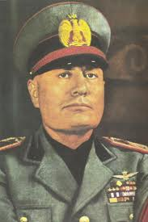
Fascism-government glorifies the state over the individual
Benito Mussolini
Italy
Created the 1st Fascist Party
1929
Hitler’s friend
Followers were called Black Shirts
Nicknamed “Il Duce”
Executed in 1945

Slide 3
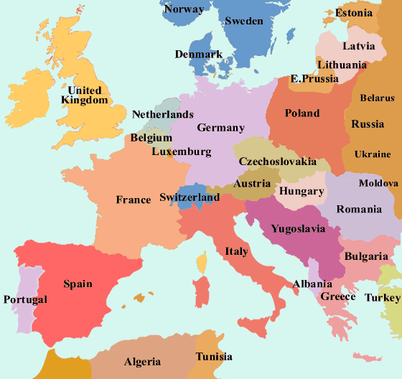
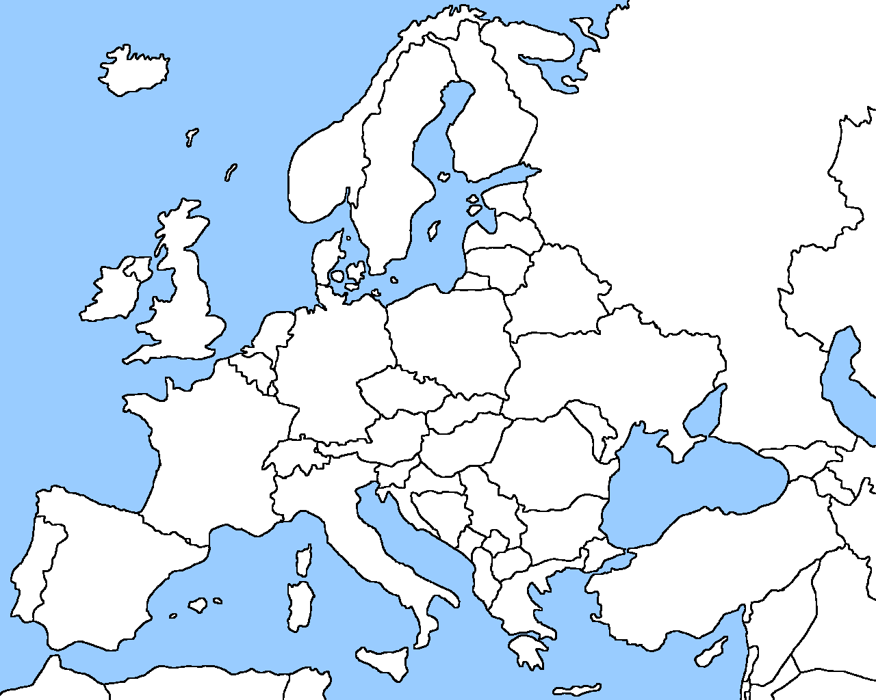
Benito ruled over Italy

Slide 4
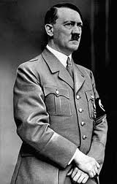
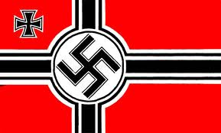
Adolf Hitler -Facism
Germany – Swastika
Led Nazi Party
Became Chancellor of Germany
Took over in 1933
Artist –wrote Mein Kamphf
Anti-Semitism
Started WWII
Committed suicide in 1945

Slide 5
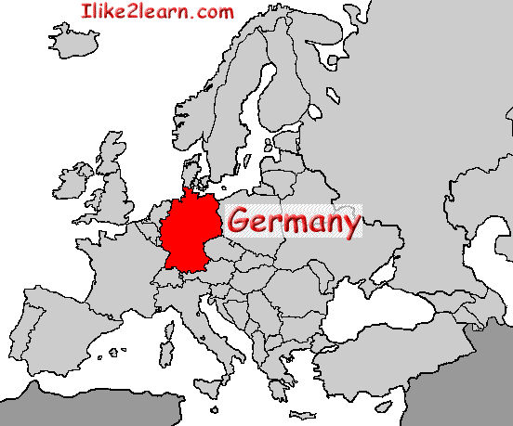
Adolf Hitler ruled over Germany

Slide 6
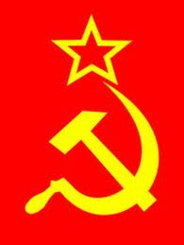
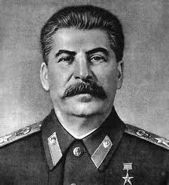
Joseph Stalin -Communist
USSR
Leader of (1929) Communist Party
Helped Allies defeat Hitler
5-year plan=have more industry
Stalinsim-brutal communism
Died 1953-naturally

Slide 7
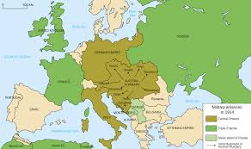
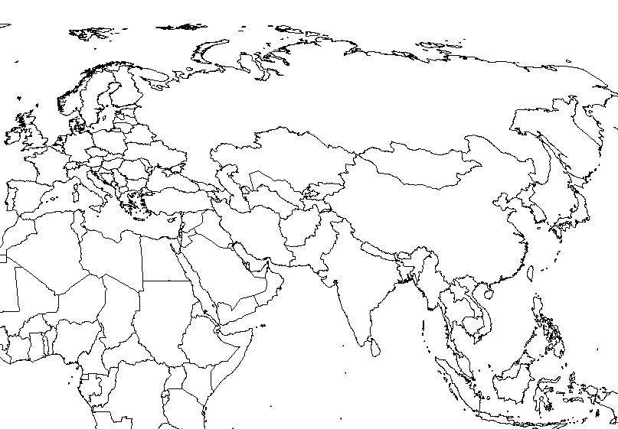
Stalin ruled over the U.S.S.R.

Slide 8
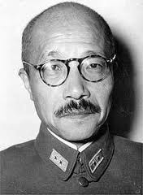
Hideki Tojo -military leader
Japan
Attacked Pearl Harbor
Friends with Hitler and Mussolini
Nickname “the Razor”
Hanged after WWII in 1948

Slide 9
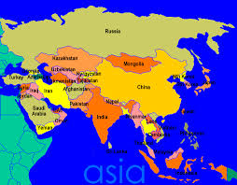
Tojo ruled over Japan

