Slide 1
Political Geography
Vocabulary
-David Dudley

Slide 2
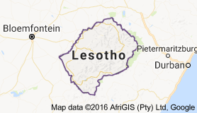
Compact State
-the geometric center of the country is relative the same distance from any border
-the “ideal” compact state would be circular in shape
EXAMPLES:
-Poland
-Zimbabwe

