Slide 1
Unit 5: Political Geography
Gerrymandering

Slide 2
Gerrymandering
Drawing legislative boundaries to favor the party in power.
A big issue in the USA
Democrats
Republican

Slide 3
Why change boundaries?
Legislative districts are areas in which people’s votes are tied to.
Districts vote and their representatives are counted.
Districts have to be redrawn so that the populations are approximately the same.

Slide 4
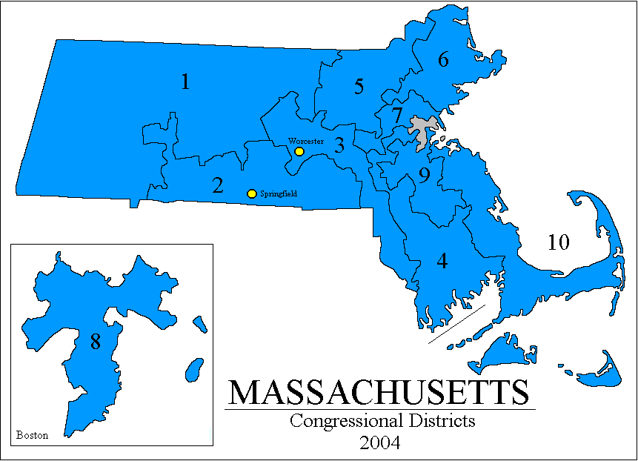
Districts

Slide 5
Legislative Districts
The boundaries of the districts are redrawn because migration changes the population.
The U.S. House of Representatives has 435 districts, they are redrawn every ten years.
They use the official Census Bureau data.

Slide 6
Gerrymandering History
Elbridge Gerry, governor of Massachusetts, (1810-1812).
Redistricted his state to support his party.
In Europe redistricting is done by independent commission, that try and create efficient shapes.

Slide 7
USA States
A few States in the USA follow the European model.
But most States allow the Legislature to redraw districts.
So the party in power tries to redraw districts to get more seat in the House of representatives.

Slide 8
Supreme Court
Made Gerrymandering illegal in 1985.
Districts stay the same until the Census every ten years.
Then both parties submit new plans for boundaries.
Because of the history of Gerrymandering, only 10% of House seats are competitive.

Slide 9
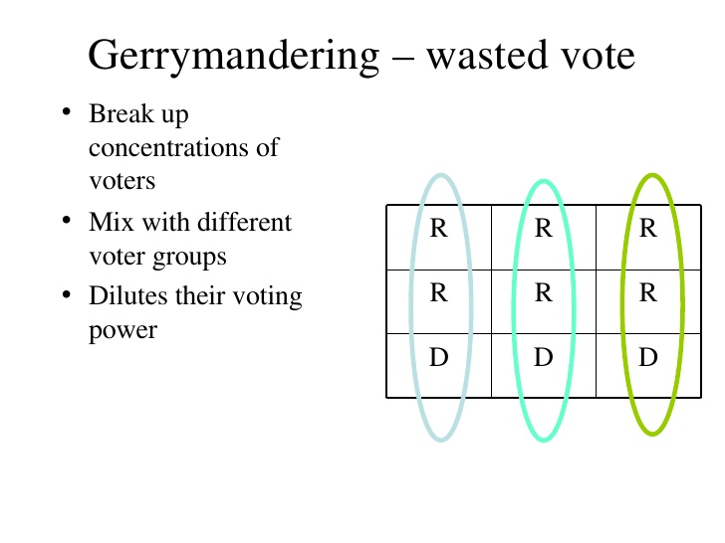
Wasted Vote Gerrymandering
Puts opposite party
members across districts
so that they are the
minority.

Slide 10
Excess Vote Gerrymandering
Putting an excess amount
of the opposite party into
one district,
and having them be
a minority in the rest.

Slide 11
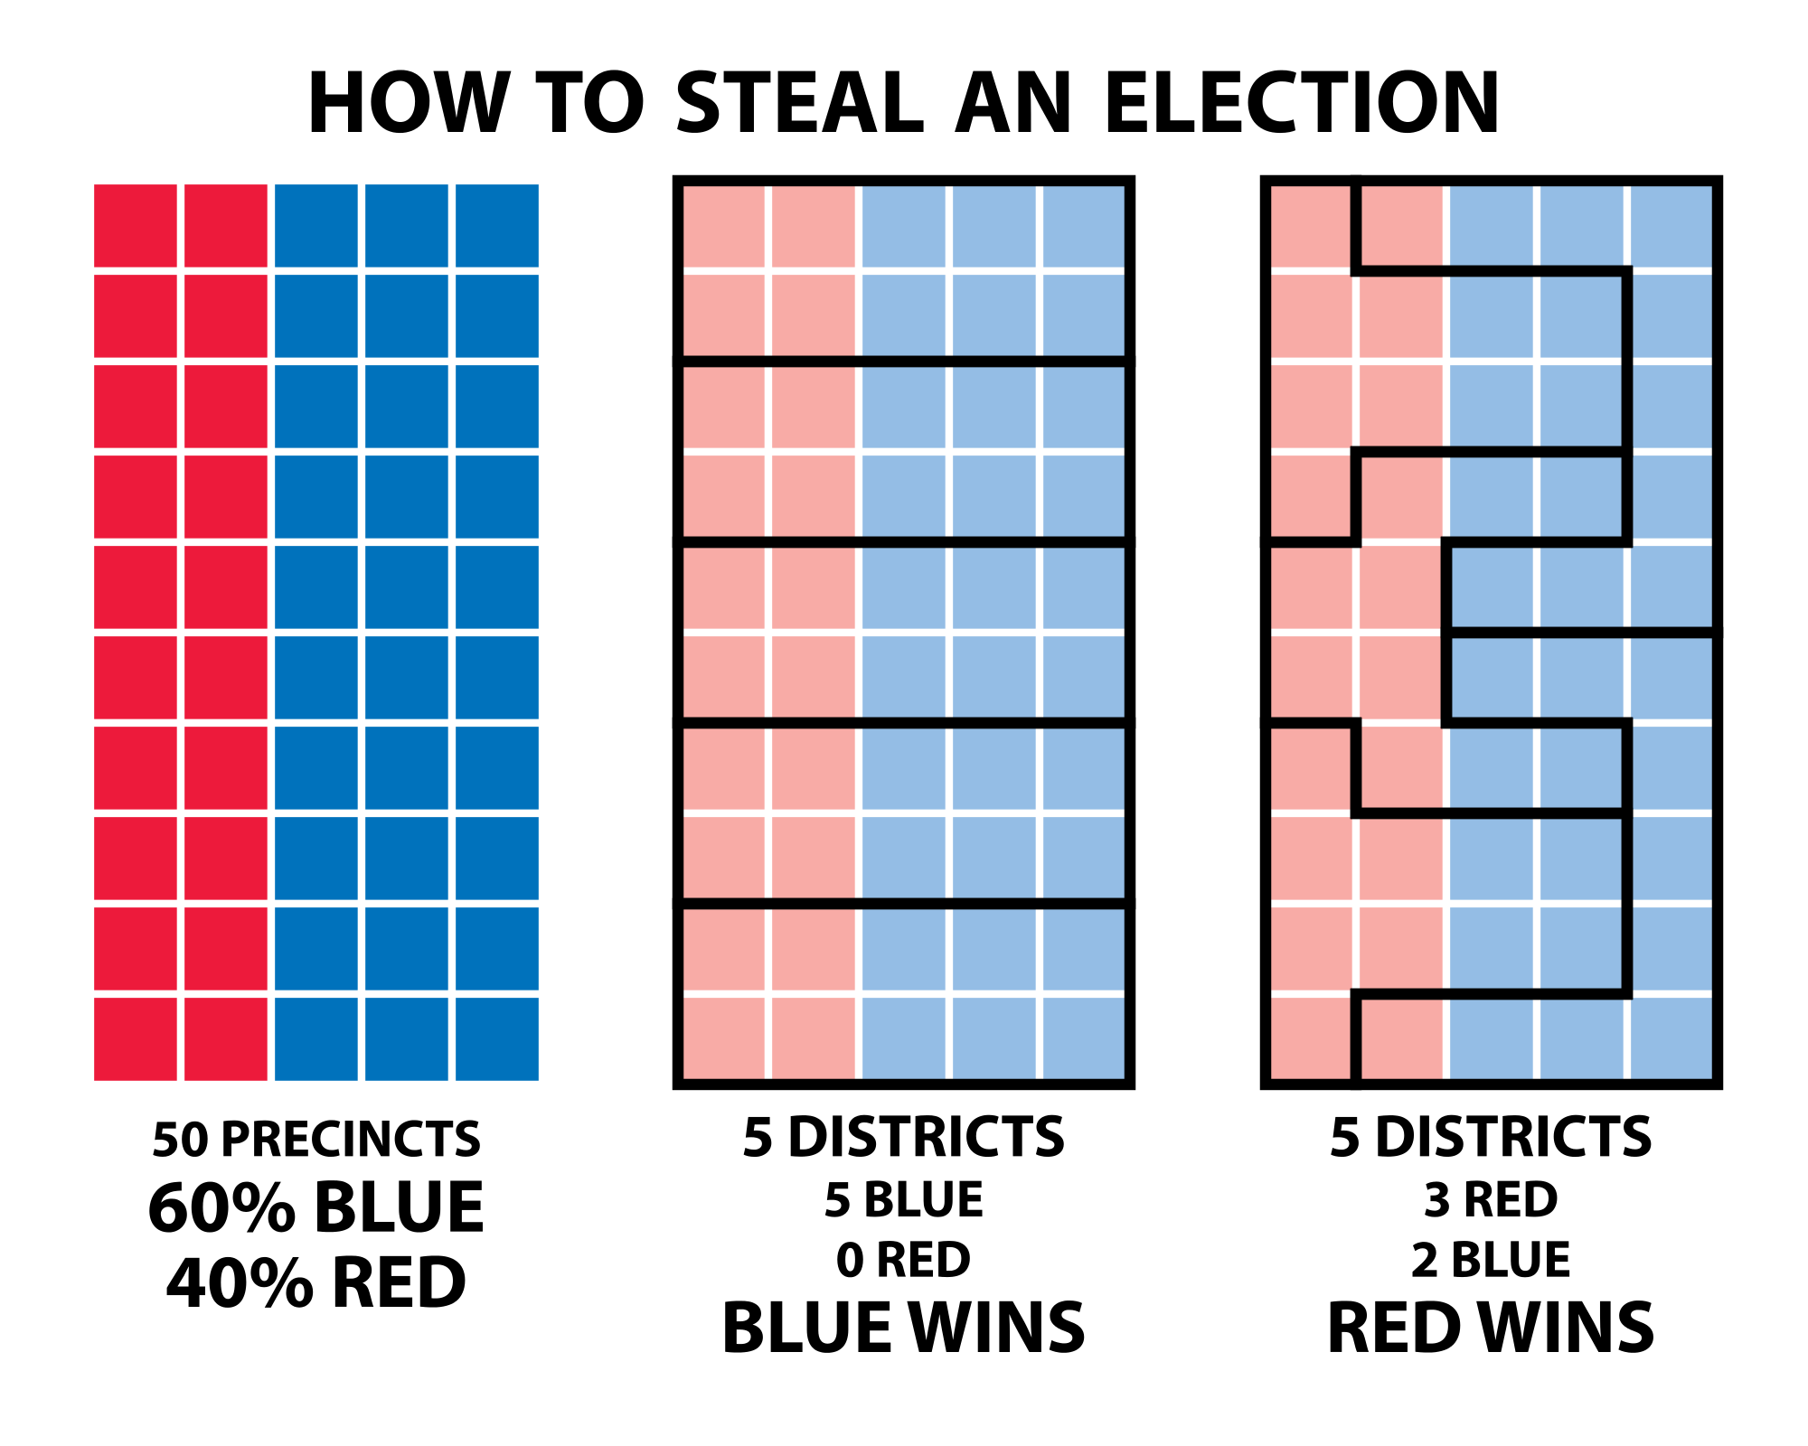
Stacked Vote Gerrymandering
Put people in the opposite party
into oddly shaped districts
so that they can stay the minority.

Slide 12
End of Gerrymandering

