Slide 1
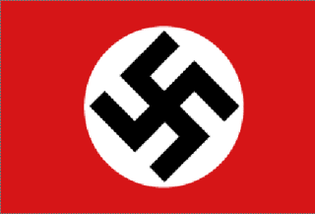
Nationalsozialistische Deutsche Arbeiterpartei

Slide 2
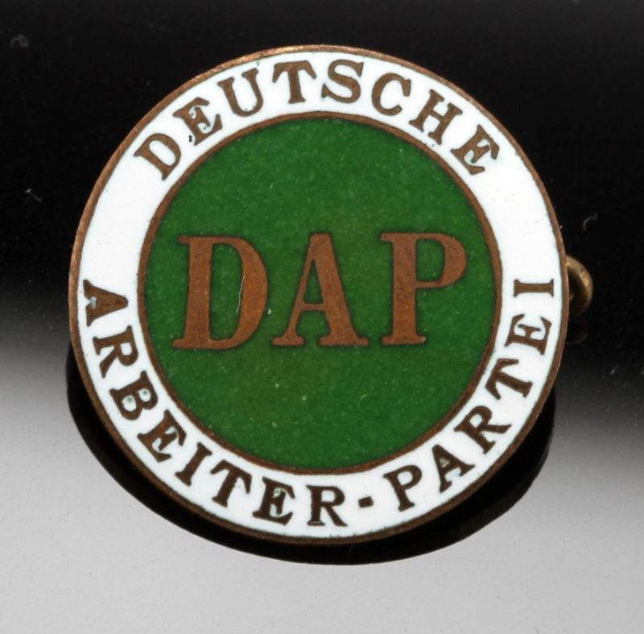
German Workers’ Party
German Worker’s Party (Deutsche Arbeiterpartei, DAP)
January 1919 to February 1920
Ideology:
Pan-Germanism
German nationalism
Anti-communist
Anti-Semitic
Anti-capitalist
Anti-Marxist

Slide 3
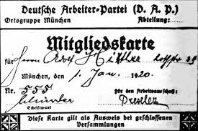
German Workers’ Party
Adolph Hitler attracted to the ideology of the DAP
Applies for membership, accepted as 55th member September 12, 1919
Hitler gives first speech October 1919, impresses all with his oratory skills
Named Chief of Propaganda early 1920
Hitler renames DAP the National Socialist German Workers’ Party, February 24, 1920

Slide 4
National Socialist German Workers’ Party
Nazi Party
Nationalistic
Anticommunist
Anti-Semitic
Attracted support of wealthy
1921 Hitler becomes head of party

Slide 5
Nazi Party
Hitler imprisoned 1923 for role in Beer Hall Putsch (revolt), puts him in national spotlight
Writes Mein Kampf
Spirit of Nazi movement
Outlines plan for racial purity including the elimination of all Jews and others considered “impure”-est. Aryan race
Blames France & others for international injustices placed on Germany after WWI
Living space

Slide 6
Nazi Party
Party shares Hitler’s anti-Semitic ideology
Emotional speeches
Disavows the Treaty of Versailles
Restore Germany’s military power
Recover lost territories

Slide 7
Nazi Party
By 1932 party growing in support
Continued civil and social unrest
Great Depression
Party gains more seats in Reichstag than any other party
Hitler becomes German citizen February 25, 1932
01/30/33 Hitler appointed Chancellor

Slide 8
Nazi Party
Reichstag fire February 27, 1933
Communists blamed by Nazis
Hitler receives emergency powers to put down “rebellion” from Hindenburg, suspends civil liberties
Hindenburg signs Enabling Act of 1933 allowing Hitler to create law for Germany

Slide 9
Nazi Party
Hitler makes law merging office of President and Chancellor upon Hindenburg’s death
Hindenburg dies August 2, 1934
Hitler declares himself “Der Fuhrer” (the leader) 2 hours later

Slide 10
Nazi Party
First Reich-Holy Roman Empire
Second Reich-German Empire of the Hohenzollerns
Third Reich-Hitler’s German Empire; last for a thousand years

Slide 11
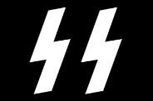
Nazi Party: der Fuhrer
Hitler turns Germ. into police state
Bans labor unions
Bans opposing newspapers, political parties, political opponents sent to camps
Sets up Gestapo and Schutzstaffel

Slide 12
Nazi Party: der Fuhrer
Persecution of inferior races
Jews forced to live in ghettos
Jews forced to wear Star of David
Concentration camps
Jews, political prisoners, criminals, gypsies, Catholics, homosexuals, disabled individuals, POWs, mentally ill, Jehovah’s Witness

Slide 13
Nazi Party: der Fuhrer
During 1930s Germany begins to secretly rebuild military
1936 Hitler orders troops into the Rhineland violating the Treaty of Versailles
France and Great Britain do nothing
1936 Rome-Berlin Axis

Slide 14
Hitler Youth
Two groups
Hitler Jungend; ages 10-14 and 14-18
League of German Maidens; ages 10-18
By 1940 membership 8 million
Boy Scouts banned
Many drafted as young as 12
Retired Pope Benedict XVI was member

Slide 15
VOCABULARY
Fascism
Communism
Black Shirts
Corporatist State
Nazism
Police State
Aryan
Third Reich
der Fuhrer
Rome-Berlin Axis
Mein Kampf

