Slide 1
Middle ages
Feudalism, Feudal Pyramid, Manorial System

Slide 2
Feudalism
Feudalism Structures Society
  850 to 950, feudalism emerges—a system based on land control
  A lord (landowner) gives fiefs (land grants) in exchange for services
  Vassals—people who receive fiefs—become powerful landholders

Slide 3
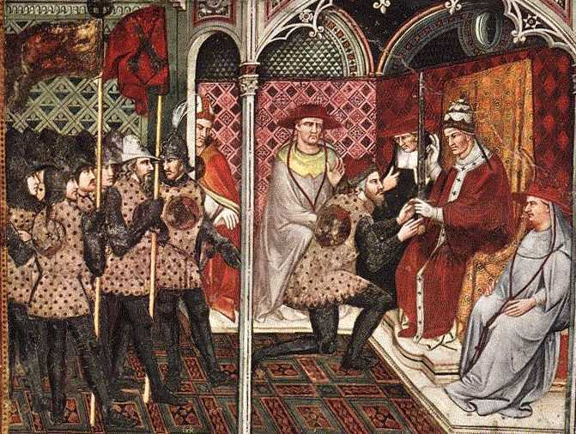
Feudalism
A political, economic, and social system in which land was allocated in exchange for services; roles and obligations were clearly defined for all participants
Grew out of Roman practices of clientage/patronage
Originally developed as a means of protection and defense
A French vassal receiving a feudal grant from the king
Notes:
Feudalism developed out of peoples’ need for protection against invaders and landowners’ need to defend their property. The feudal system grew out of the practices of “clientage” or “patronage” which had existed under the Roman Empire; these practices involved smaller landowners placing themselves under the protection of larger landowners, usually in exchange for payment or goods. In medieval feudalism, individual monarchs throughout Europe were unable to afford protection of their empires, so they gave trusted soldiers parcels of land in exchange for their promise to defend it and make it useful.
Feudalism appeared in Europe during the 700s in the areas we know now as France and Germany, as weak governments sought solutions to the question of how to provide security with limited resources. By the 1000s, most of western Europe practiced some form of feudalism.

Slide 4
Feudalism
Social Classes Are Well Defined
  Medieval feudal system classifies people into three social groups
    those who fight: nobles and knights
    those who pray: monks, nuns, leaders of the Church
    those who work: peasants
  Social class is usually inherited; majority of people are peasants
  Most peasants are serfs—people lawfully bound to place of birth
  Serfs aren’t slaves, but what they produce belongs to their lord

Slide 5
Feudalism
Increasing violence and lawless countryside
Weak turn to the strong for protection, strong want something from the weak
Feudalism= relationship between those ranked in a chain of association (kings, vassals, lords, knights, serfs)
Feudalism worked because of the notion of mutual obligation, or voluntary co-operation from serf to noble
A man’s word was the cornerstone of social life
Key terms
Fief = land given by a lord in return for a vassal’s military service and oath of loyalty
Serfs= villeins, or common peasants, who worked the lords land
Tithe = tax that serfs paid (tax or rent)
Corvee= condition of unpaid labor by serfs (maintaining roads or ditches on a manor)

Slide 6
Feudalism
Hierarchical system in which every man is another man’s vassal (or servant)
hardly any movement at all through the system in early MA
A bit more movement in high and late MA
Manor: estate
Lord: head of manor
Lady: wife of lord
Knight: Lord/son of Lord
Vassal: underlord; feudal tenant
Serf: workers; bound to the lord of the castle; 4/5 of income went to the lord; no chance to change your life if you were a serf; no way to work your way up; no time for theater, etc.

Slide 7
Feudalism
The Feudal Pyramid
  Power in feudal system much like a pyramid, with king at the top
  Kings served by nobles who are served by knights; peasants at bottom
  Knights—horsemen—defend their lord’s land in exchange for fiefs

Slide 8
Feudalism
KINGS:
Kings at top of hierarchy; collected from barons
As God’s deputy on earth (“divine right of kings”), can’t question the king’s authority
BARONS:
Important noblemen
Rich and powerful
Barons collected from lords, lords collected from peasants, etc.
Land was almost the only form of wealth; Rank and power were determined by the amount of land you had.

Slide 9
Feudalism
BISHOPS:
Of the church
Were often of equal power to barons; had property and wealth
Fief [feef]: grant of land given directly by the king; in return, nobelmen gave the king soldiers in wartime.
LORDS (KNIGHTS):
first and foremost a lord was a knight by profession: provided men and arms for baron and king.
Also often raided each others’ properties.
  Chivalry: medieval institution of knighthood; qualities idealized by knights—bravery, courtesy, honesty

Slide 10
Feudalism
FREEMEN:
owned their own land independently of a lord
In early feudalism, freemen were limited to the LORDS’ APPOINTED OFFICIALS, and A FEW MERCHANTS AND CRAFTSMEN (much more in later middle ages as economy changed).

Slide 11
Feudalism
PEASANTS (SERFS/VILLEINS)/SLAVES):
Lived on the lord’s manor.
Peasants’ work: EVERYTHING—land, animals, animals’ dung, homes, clothes, BELONGED TO THE LORD OF THE MANOR.
Couldn’t leave the manor property without permission
More than 90% of the population were peasants or slaves, according to the Domesday Book (pronounced Dooms-day, and DOES mean that; suggests it is a definitive census).

Slide 13
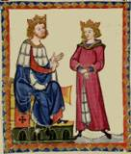
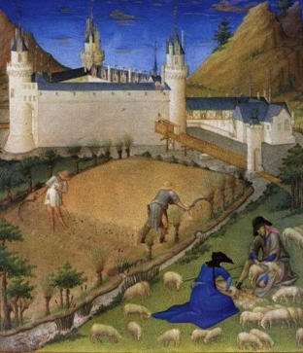
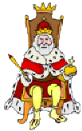
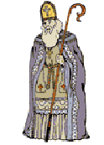
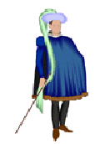

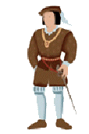
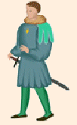

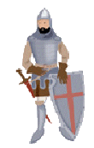
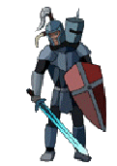
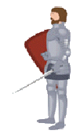
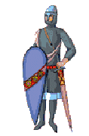
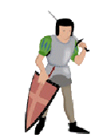
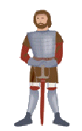
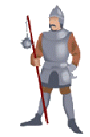
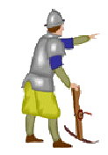
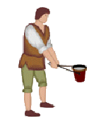

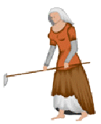

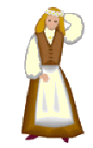
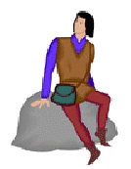

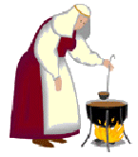
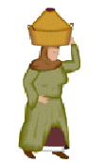

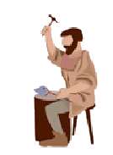
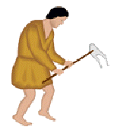
MEDIEVAL LIFE
Cooperation and Mutual Obligations
KING
FEUDALISM:
POLITICAL SYSTEM
Decentralized, local government
Dependent upon the relationship between members of the nobility
Lord and his vassals administered justice and were the highest authority in their land
MANORIALISM:
ECONOMIC SYSTEM
Agriculture the basis for wealth
Lands divided up into self-sufficient manors
Peasants (serfs) worked the land and paid rent In exchange for protection
Barter the usual form of exchange
Fief and Peasants
Fief and Peasants
Loyalty
Military Aid
LORDS (VASSALS TO KING)
Food Protection Shelter
Food Protection Shelter
Homage
Military Service
KNIGHTS (VASSALS TO LORDS)
Food Protection Shelter
Farm the Land
Pay Rent
PEASANTS (SERFS)

Slide 14
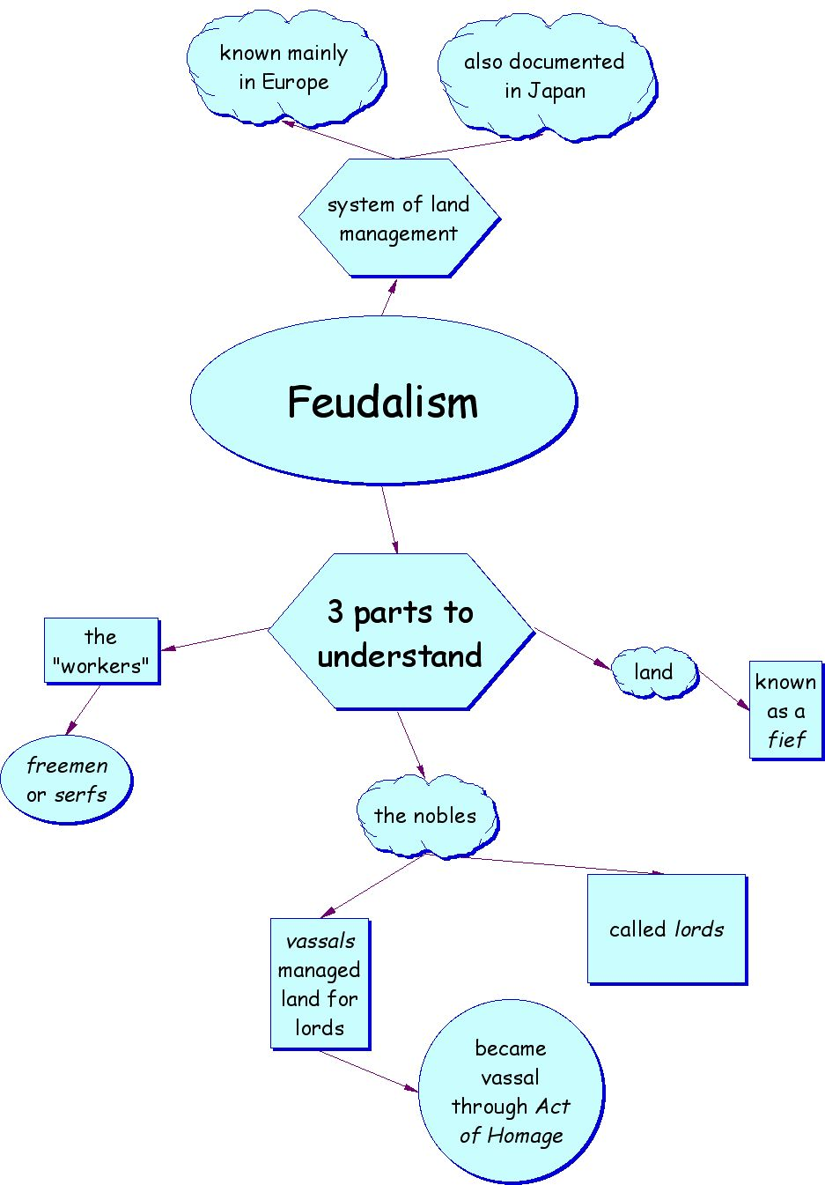

Slide 15
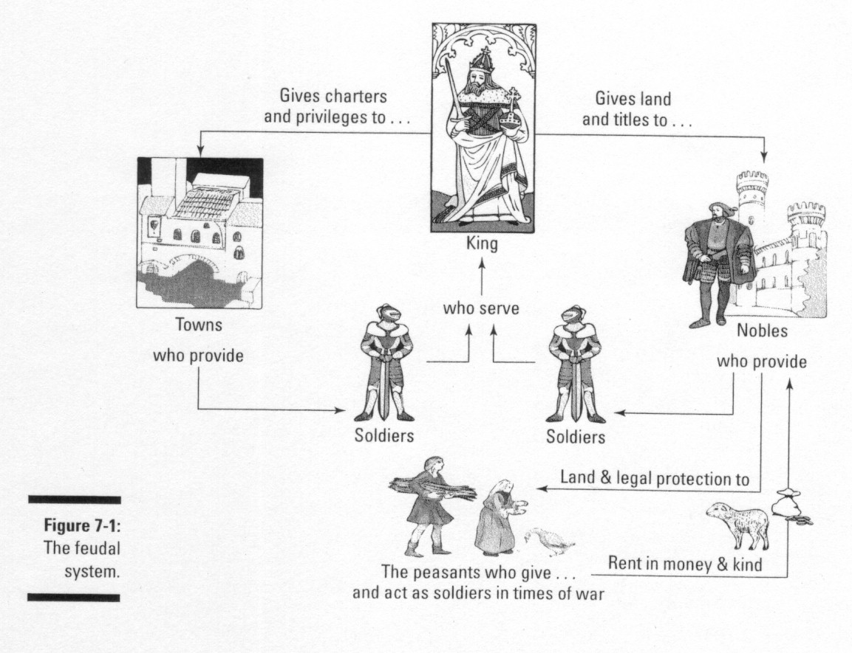

Slide 16
Manorial System
The economic side of feudalism
The Lord’s Estate
  The lord’s estate, a manor, has an economic system (manor system)
  Serfs and free peasants maintain the lord’s estate, give grain
  The lord provides housing, farmland, protection from bandits

Slide 18
Manors: The Economic Side of Feudalism
A Self-Contained World
  Medieval manors include lord’s house, church, workshops, village
  Manors cover a few square miles of land, are largely self-sufficient

Slide 19
Manorial System
The Harshness of Manor Life
  Peasants pay taxes to use mill and bakery; pay a tithe to priest
  Tithe—a church tax—is equal to one-tenth of a peasant’s income
  Serfs live in crowded cottages with dirt floors, straw for beds
  Daily grind of raising crops, livestock; feeding and clothing family
  Poor diet, illness, malnutrition make life expectancy 35 years
  Serfs generally accept their lives as part of God’s plan

Slide 20
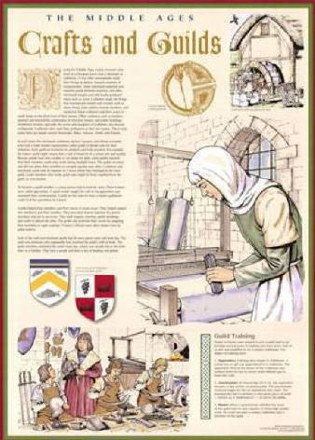
Guilds
Guilds were established to gain higher wages for their members and protect them from competitors. As the guilds grew rich and powerful, they built guildhalls and began taking an active role in civic affairs, setting up courts to settle disputes and punish wrongdoers.

Slide 21
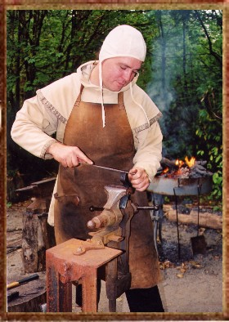
Merchant Class
The new merchant class included artisans, masons, armorers, bakers, shoemakers, ropemakers, dyers, and other skilled workers.

Slide 22
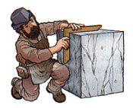
Masons
Of all the craftsmen, the highest paid and most respected.
Responsible for building cathedrals, hospitals, universities, castles, and guildhalls.

Slide 23
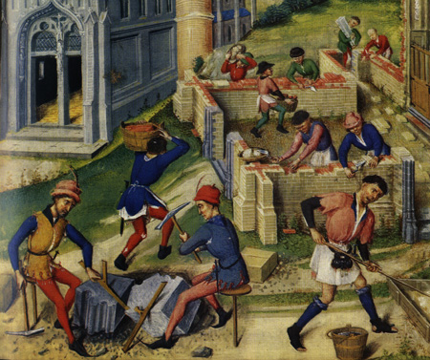
Apprentices
Masons learned their craft as apprentices to a master mason, living at lodges for up to seven years. The master mason was essentially an architect, a general contractor, and a teacher.

Slide 24
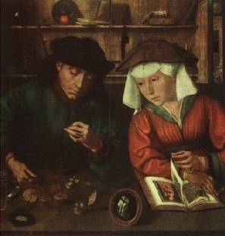
The First Companies
The population of cities swelled for the first time since before the Dark Ages.
With the new merchant activity, companies were formed.
Merchants hired bookkeepers, scribes, and clerks, creating new jobs.

