Slide 1
INTRODUCTION TO GOVERNMENT

Slide 2
What is a “state” ?
From the Latin stare (to stand)
Political community
Occupies a defined, specific territory
Organized government to make “rules”
Sovereignty: with the authority to make and enforce laws without the consent of a higher authority.
* Today it is synonymous with the term country, nation-state, and city-state
* Not to be confused with nation, which is defined as a group of people united by some common bond.

Slide 3
Features of a State
Population
Territory / land
Sovereignty – supreme and absolute power within its territorial boundaries.
Government – the institution and processes through which the state maintains social order, provides public services, and enforces binding decisions.

Slide 4
Origins of the State
How did states and governments come into being? Four theories:
Evolution Theory
Force Theory
Divine Right
Social Contract

Slide 5
Evolution Theory
States evolved from primitive family units – hunter gatherers
Families grew into large extended units or tribes; begin to settle in certain areas; farming
Heads of the family served as a government
Evolved into tribal councils with a hierarchy of authority

Slide 6
Force Theory
Governments emerged when people are were brought under the control of some authority and the people are forced to submit to rule
Single person
Groups of people
States emerged/got larger from the conquest of other families or tribes

Slide 7
Divine Right
It was thought that “God” created the state, therefore people believed that kings are chosen by a deity/god to rule the state
examples include ancient Egyptians and Aztecs
15th Century Europe, the belief is used by royalty as the justification for absolute rule
To question the king was not only treason but seen as a sin against the god

Slide 8
Social Contract
17th Century & The Age of Enlightenment
People begin to challenge the monarchy and the idea of Divine Right
“Enlightened” thinkers promote the concept of government by social contract
The people give up some rights to a government in order to receive the benefits of government for their own well-being

Slide 9
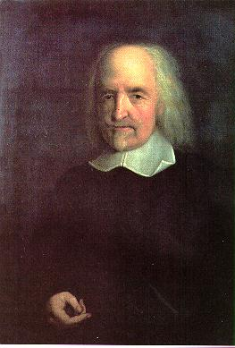
Thomas Hobbes ~ Social Contract
In a “state of Nature” there is no government and man is free.
However, absolute freedom has a price… life is “cruel, brutish and short”
To escape this cruel reality, men would give up some freedom to the state; in return the government (state) would offer people security through law & order

Slide 10
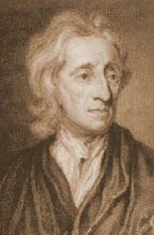
John Locke ~ Social Contract
Locke took Hobbes’ ideas one step further by promoting the “right to revolution”
Locke believed that if the government fails to provide people with security or if the state abused its power over the people the people had the right to overthrow the government for a “better” government.

Slide 11
Types of Government
Autocracy
Oligarchy
Democracy

Slide 12
Government
Government Types
Autocracy
Power and authority to rule held by one person
Absolute Monarchy, Constitutional Monarchy, Dictatorship, Totalitarian dictatorships
Unitary System
Queen, King, Dictator, King or Queen w/leg.body
AM: Saudi Arabia, Qutar, Bhutan, Swaziland
CM: England, Netherlands, Denmark, Nepal, Sweden
Dictatorship: Cuba, North Korea

Slide 13
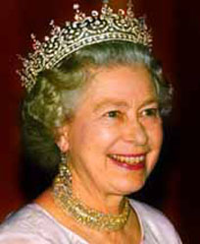
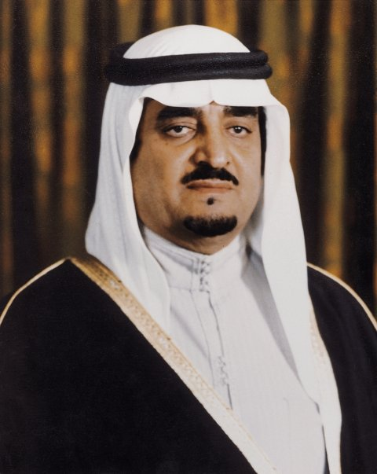
Government
Constitutional Monarch:
Shares govt. powers with elected legislatures or serve as ceremonial leaders
Queen Elizabeth II
(Great Britain)
Absolute Monarch:
Has complete and unlimited power to rule
King Fahd
(Saudi Arabia)

Slide 14
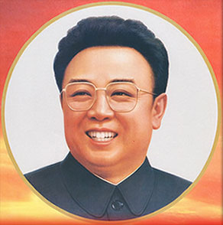
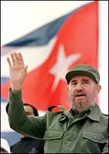
Government
Dictators
Govt. not responsible to the people and people lack the power to limit their rulers
Raul Castro (Fidel’s brother
(Cuba)
Kim Jong
(N.Korea)

Slide 15
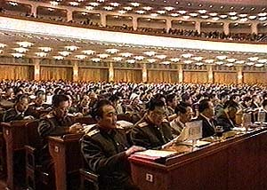
Government
Government Types
Oligarchy: Power and authority to rule is held by a small group of individuals
Unitary
Small group rules
Membership based on wealth, lineage, military power, religion
China

Slide 16
Democracies
From the Greek demos (people) and kratia (to rule). Thus ~ rule by the people
Too simple & naïve
Democracy is a system of government in which people select policy makers so that policies reflect the will of those governed.

Slide 17
Government
Government Types
Democracy
Federal
Direct Democracy – people rule directly
Citizens come together to discuss and pass laws, and select rulers (most turn to mob rule)
Indirect Democracy (Representative) – people rule through elected representatives
Aka republic
DD: Switzerland has mixture of DD and ID
ID: U.S., Canada, Australia, Italy

Slide 18
Two Forms of Democracy
Direct democracy allows the people the authority to govern themselves directly
People make and vote on policies in forums
Only exist in small communities today
Representative democracy people select representatives and give them authority to make laws and run the government
Also known as: republic, indirect democracy and constitutional republic
Still in all, power ultimately rests with the public

Slide 19
Forms of Government-Examples
Autocracy
Absolute Monarchy
Constitutional Monarchy-shared monarchy
Dictatorship
Paparchy-government by the pope
Monocracy-government by one person
Ideocracy-self rule

Slide 20
Forms of Government-Examples
Oligarchy
Aristocracy-government by nobility
Meritocracy-government by those who are worthy
Plutocracy-government by the rich

Slide 21
Forms of Government-Examples
Democracy
Sociocracy-governemnt by all of society
Pantarchy-world government
Panarchy –universal government

Slide 22
Basis of Government
Economy
Politics
Authority

Slide 23
Basis of Government
Economy
Capitalism
Socialism
Communism

Slide 24
Basis of Government
Politics
Dictatorship
Totalitarian
Theocracy
Parliamentary
Republic
Anarchy

Slide 25
Basis of Government
Authority
Revolutionary
Totalitarian
Oligarchy/Plutocracy
Democracy

