Slide 1
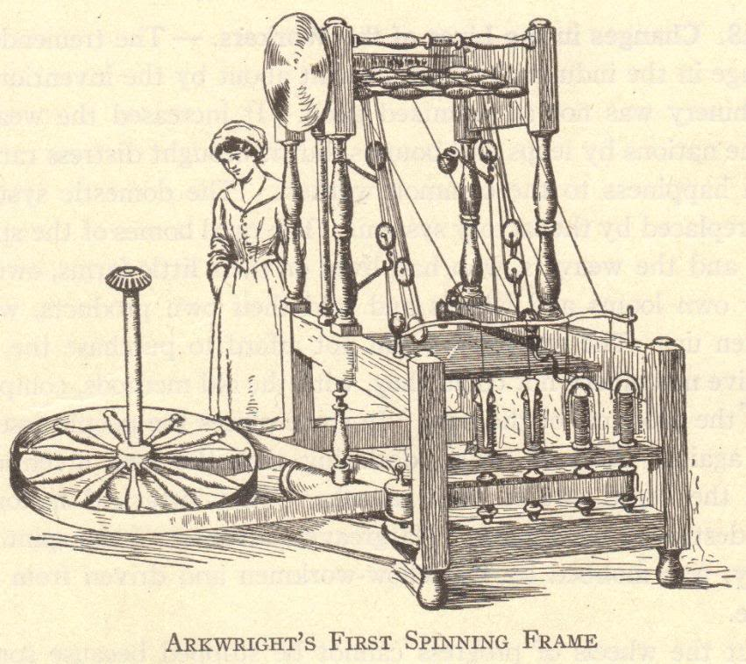
The First Industrial Revolution

Slide 2
What was the Industrial Revolution?
The Industrial Revolution was a fundamental change in the way goods were produced, from human labor to machines
The more efficient means of production and subsequent higher levels of production triggered far-reaching changes to industrialized societies

Slide 3
The Industrial Revolution
Machines were invented which replaced human labor
New energy sources were developed to power the new machinery – water, steam, electricity, oil (gas, kerosene)
Some historians place advances in atomic, solar, and wind energy at the later stages of the Industrial Revolution
Increased use of metals and minerals
Aluminum, coal, copper, iron, etc.

Slide 4
The Industrial Revolution
Transportation improved
Ships
Wooden ships → Iron ships → Steel ships
Wind-powered sails → Steam-powered boilers
Trains
Automobiles
Communication improved
Telegraph
Telephone
Radio

Slide 5
Developments
Mass production of goods
Increased numbers of goods
Increased diversity of goods produced
Development of factory system of production
Rural-to-urban migration
People left farms to work in cities
Development of capitalism
Financial capital for continued industrial growth
Development and growth of new socio-economic classes
Working class, bourgeoisie, and wealthy industrial class
Commitment to research and development
Investments in new technologies
Industrial and governmental interest in promoting invention, the sciences, and overall industrial growth

Slide 6
Background of the Industrial Revolution
Commercial Revolution
15th, 16th, and 17th centuries
Europeans expanded their power worldwide
Increased geographic knowledge
Colonies in the Americas and Asia
Increased trade and commerce
Guild system could not meet the demands of increasing numbers goods

Slide 7
Development of the Domestic System of Production
Domestic system developed in England
Late 1600s-late 1800s
Domestic system of production – “putting out” system
Businesspeople delivered raw materials to workers’ homes
Workers manufactured goods from these raw materials in their homes (typically articles of clothing)
Businesspeople picked up finished goods and paid workers wages based on number of items
Domestic system could not keep up with demand

Slide 8
Factory System
Developed to replace the domestic system of production
Faster method of production
Workers concentrated in a set location
Production anticipated demand
For example: Under the domestic system, a woman might select fabric and have a businessperson give it to a home-based worker to make into a dress. Under the factory system, the factory owner bought large lots of popular fabrics and had workers create multiple dresses in common sizes, anticipating that women would buy them.

Slide 9
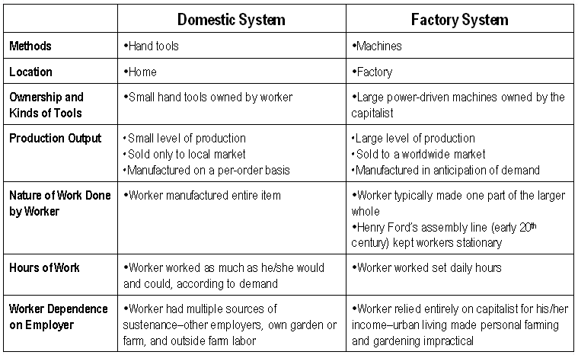

Slide 10
Why the Industrial Revolution Started in England
Capital for investing in the means of production
Colonies and Markets for manufactured goods
Raw materials for production
Workers
Merchant marine
Geography

Slide 11
England’s Resources: Capital
The Commercial Revolution made many English merchants very wealthy
These merchants had the capital to invest in the factory system – money to buy buildings, machinery, and raw materials

Slide 12
England’s Resources: Colonies and Markets
Wealth from the Commercial Revolution spread beyond the merchant class
England had more colonies than any other nation
Its colonies gave England access to enormous markets and vast amounts of raw materials
Colonies had rich textile industries for centuries
Many of the natural cloths popular today, such as calico and gingham, were originally created in India
China had a silk industry

Slide 13
England’s Resources: Raw Materials
England itself possessed the necessary raw materials to create the means of production
Coal – vast coal reserves powered steam engines
Iron – basic building block of large machines, railroad tracks, trains, and ships

Slide 14
England’s Resources: Workers
Serfdom and guilds ended earlier in England than other countries
English people could freely travel from the countryside to the cities
Enclosure Acts – caused many small farmers to lose their lands, and these former farmers increased the labor supply

Slide 15
England’s Resources: Merchant Marine
World’s largest merchant fleet
Merchant marine built up from the Commercial Revolution
Vast numbers of ships could bring raw materials and finished goods to and from England’s colonies and possessions, as well as to and from other countries

Slide 16
England’s Resources: Geography
England is the political center of Great Britain, an island
Great Britain (as the entire island was called beginning in 1707) did not suffer fighting on its land during the wars of the 18th century
Island has excellent harbors and ports
Damp climate benefited the textile industry (thread did not dry out)
Government stable
No internal trade barriers

Slide 17
The Textile Industry
Textiles – cloths or fabrics
First industry to be industrialized
Great Britain learned a lot about textiles from India and China

Slide 18
The Birth and Growth of the Textile Industry
John Kay (English)
Flying shuttle, 1733
Hand-operated machine which increased the speed of weaving
James Hargreaves (English)
Spinning jenny, 1765
Home-based machine that spun thread 8 times faster than when spun by hand
Richard Arkwright (English)
Water frame, 1769
Water-powered spinning machine that was too large for use in a home – led to the creation of factories

Slide 19
The Birth and Growth of the Textile Industry
Samuel Crompton (English)
Spinning mule, 1779
Combined the spinning jenny and the water frame into a single device, increasing the production of fine thread
Edward Cartwright (English)
Power loom, 1785
Water-powered device that automatically and quickly wove thread into cloth
Eli Whitney (American)
Cotton gin, 1793
Device separated raw cotton from cotton seeds, increasing the cotton supply while lowering the cost of raw cotton
Elias Howe (American)
Sewing machine, 1846
Speed of sewing greatly increased

Slide 20
Development of Steam Engines
Early water power involved mills built over fast-moving streams and rivers
Early water power had problems
Not enough rivers to provide the power needed to meet growing demand
Rivers and streams might be far removed from raw materials, workers, and markets
Rivers are prone to flooding and drying

Slide 21
Steam Power
Humans tried harnessing steam power for millennia
Hero of Alexandria, Egypt – created a steam-driven device in the 1st century B.C.E.
Thomas Newcomen, England (1704)
Created a steam engine to pump water from mines
James Watt, Scotland (1769)
Improved Newcomen’s engine to power machinery

Slide 22
Bessemer Process and Steel
Prior to the Industrial Revolution, steel was difficult to produce and expensive
Henry Bessemer, 1856
Developed the Bessemer process
Brought on the “Age of Steel”
Steel is the most important metal used over the past 150+ years
Other improvements in steel production
Open-hearth furnace
Electric furnace
Use of other metals to produce various types of steel

Slide 23
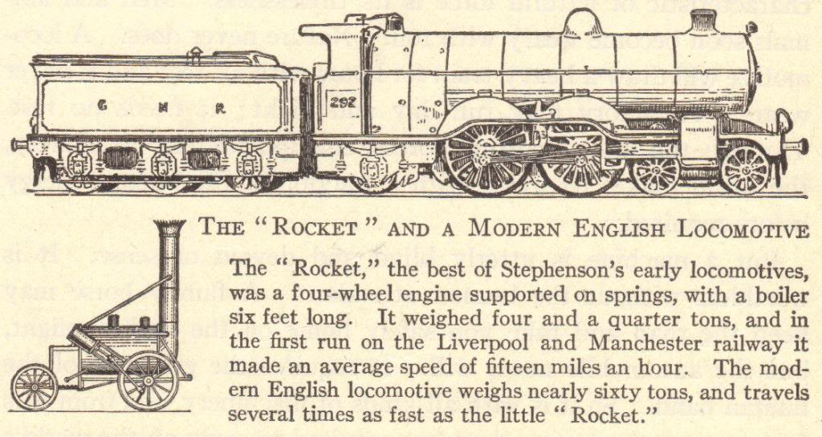
Transportation
Increased production
Search for more markets and raw materials
Better and faster means of transportation
Before the Industrial Revolution
Canal barges pulled by mules
Ships powered by sails
Horse-drawn wagons, carts, and carriages
After the Industrial Revolution
Trains
Steamships
Trolleys
Automobiles

Slide 24
Transportation Revolution
Robert Fulton (American)
Steamboat (1807)
Sped water transportation
Thomas Telford and John McAdam (British)
Macadamized roads (1810-1830)
George Stephenson (English)
Locomotive (1825)
Improved roads
Fast land transport of people and goods
Gottlieb Daimler (German)
Gasoline engine (1885)
Led to the invention of the automobile
Rudolf Diesel (German)
Diesel engine (1892)
Cheaper fuel
Orville and Wilbur Wright (American)
Airplane (1903)
Air transport

Slide 25
Steamboats
Robert Fulton invented the steamboat in 1807
The Clermont operated the first regular steamboat route, running between Albany and New York City
1819 – the Savannah used a steam engine as auxiliary power for the first time when it sailed across the Atlantic Ocean
1836 – John Ericsson invented a screw propeller to replace paddle wheels
1838 – the Great Western first ship to sail across the Atlantic on steam power alone, completing the trip in 15 days

Slide 26
Railroads
1830 – Stephenson’s “Rocket” train traveled the 40 miles between Liverpool and Manchester in 1 ½ hours
1830-1870 – railroad tracks went from 49 miles to over 15,000 miles
Steel rails replaced iron rails
1869 – Westinghouse’s air brake made train travel safer
Greater train traveling comfort – heavier train cars, improved road beds, and sleeping cars

Slide 27
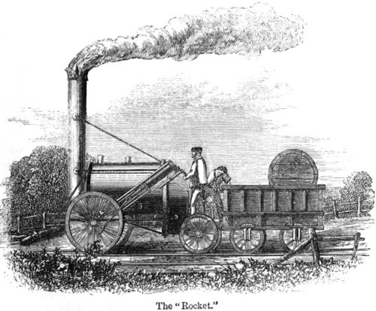

Slide 28
Communications Revolution
Samuel F.B. Morse (American)
Telegraph (1844)
Rapid communication across continents
Alexander Graham Bell (American)
Telephone (1876)
Human speech heard across continents
Cyrus W. Field (American)
Atlantic cable (1866)
United States and Europe connected by cable
Guglielmo Marconi (Italian)
Wireless telegraph, an early form of the radio (1895)
No wires needed for sending messages
Lee de Forest (American)
Radio tube (1907)
Radio broadcasts could be sent around the world
Vladimir Zworykin (American)
Television (1925)
Simultaneous audio and visual broadcast

Slide 29
Review Questions
What was the Industrial Revolution?
Describe at least three developments of the Industrial Revolution.
Compare and contrast the domestic and factory methods of production.
Why did the Industrial Revolution begin in England?
Explain why one invention or development leads to another.

Slide 30
Review Questions
Explain how developments in the textile industry sparked the Industrial Revolution.
Describe at least three developments in the area of transportation.
Describe at least three developments in the field of communications.
Considering the conditions necessary for industrialization to occur, how well equipped is the undeveloped world for becoming industrialized? Are modern undeveloped nations in a better or worse position than 18th- and 19th-century England?
Notes:
Note: Answers to all questions are found on slides 1-43. Question 9 is open to discussion and interpretation.

