Slide 1
IMPERIALISM
Vocabulary

Slide 2
Monday’s Vocabulary
Imperialism- term used for Europeans carving up Africa for its colonial uses
Nationalism- love of one’s country above all else
Industrialism- process of moving from hand-made products to machine-enable manufacturing

Slide 3
Tuesday’s Vocabulary
Rudyard Kipling- British author of various works including The Jungle Book and White Man’s Burden
White Man’s Burden- Poem extolling the duty of stronger nations to impose their superior culture on inferior, “backward” peoples (1899)
Social Darwinism- idea of society based on survival of the fittest

Slide 4
Wednesday’s Vocabulary
Spheres of Influence- areas of a territory divided by imperialist countries to control trade and economic rights
Scramble for Africa- the rush by Western countries in the 1880s to divide Africa into colonies for raw materials
Berlin Conference- 14 European nations meet in Germany in 1884-1885 to divide Africa among themselves

Slide 5
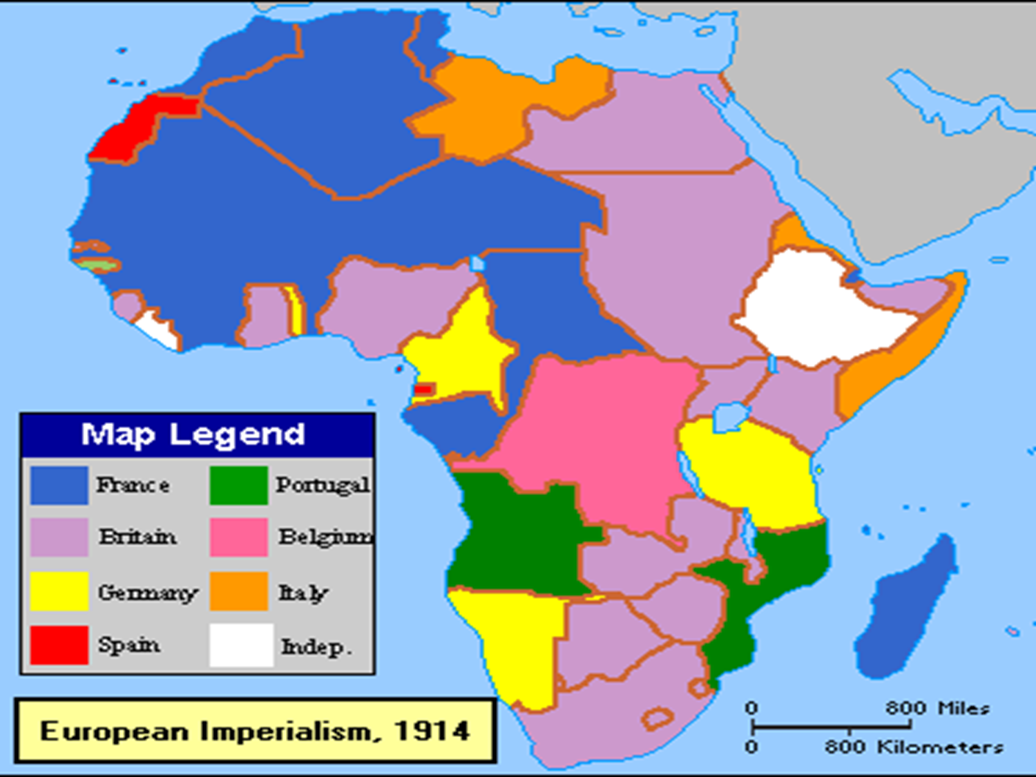

Slide 6
Map Questions
1. What two areas of Africa remained independent (describe locations).
2. Which two European countries controlled most of Africa?
3. Which European country controlled the large island off the east coast?
4. Which European country had colonies closest to Europe?
5. Which European country had no African colonies north of the equator?

Slide 7
Friday’s Vocabulary
Meiji Restoration- period of industrialization in Japan, led to Japanese imperialism (1868-1912)
Opium Wars- war China lost to Great Britain, forced China to sign treaty opening up western trade (1860)
“Open Door Policy”- created by the US to open China to trade by all nations, not just Great Britain (1899)
Commodore Matthew Perry- US naval officer tasked with opening Japan to trade by show of force (1853)

Slide 8
Wednesday Vocabulary
Sepoys: Indian soldiers, Hindu and Muslim
Sepoy Rebellion: 1857, gun cartridges in the army were greased with beef and pork fat and the cartridge ends had to be bitten off in order to be used, Hindus and Muslims are forbidden from ingesting beef and pork, the Sepoys considered this to be offensive to their religion, led a revolt against the British.
“Jewel of the Crown”: India supplied raw materials to Britain’s industries AND was viewed as a potential market for the finished products
Sino-Japanese War: 1894, Japan went to war with China in order to try to gain control of trade in Korea, China had been in control of Korea at the time, Japan was able to demonstrate to China and the world its new industrial might by quickly defeating China, Japan gained control of Korea as a result.

Slide 9
Thursday Vocabulary
Russo-Japanese War: 1904-5, Russia wanted access to trade with Korea, Japan was still in control of Korea, Russians sent a naval fleet headed to Korea, the Japanese navy met them at sea and destroyed much of the Russian Naval Fleet
Society of Righteous and Harmonious Fists (aka the Boxers): a Chinese nationalistic organization, used martial arts to try to remove foreigners from Chinese soil and rid China of foreign influence
Boxer Rebellion:. The Boxers began killing many foreigners and Chinese Christians, while also causing major damage to foreign-owned businesses. The Boxers were defeated by an eight-nation alliance. The Chinese government was forced to pay the nations involved for damages done by the Boxers in the rebellion, and the eight nations were allowed to maintain their spheres of influence. Although the rebellion was a failure, it did lead to an increasing sense of nationalism and need for reform in China.
Taiping Rebellion: Chinese internal rebellion, an attempt to establish a kingdom in which no one would live in poverty, unsuccessful

Slide 10
Monday Vocabulary
Zulu War: 1880s, British against the Zulus as they tried to keep their independence, showed the growing sense of nationalism within the Zulu Kingdom; Zulu nation did not have the same amount of weapons that the British had and were defeated; led to the Zulu nation becoming part of the British Empire
Boers: long-time Dutch settlers in Africa
Afrikaners: long-time Dutch settlers in Africa, also known as Boers

