Slide 1
European Claims Sub-Saharan Africa

Slide 2
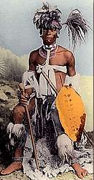
Africa Before Imperialism
Divided into 100’s of ethnic & linguistic groups
Mixture of large empires & small independent villages
Most practiced traditional beliefs
Others practiced Islam & Christianity

Slide 3
Early European Contact
Established contact in early 1450’s
Contact limited to coastal territory
Interior travel limited due to navigability of rivers & disease
Large networks of Africans controlled trade (gold & ivory)
European interest based on slave Trade (Triangular trade)

Slide 4
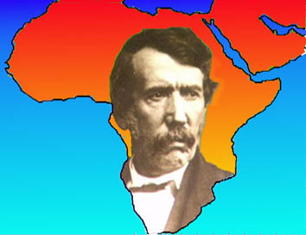
Exploration of the Interior
Known as the Dark Continent
1860’s Scottish missionary David Livingstone- first European to explore Sub- Saharan Africa
Reported lush forests, waterfalls, & grasslands
Discovers Victoria Falls

Slide 5
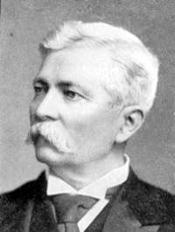
1871 Am. Henry Stanley searches/finds Livingstone
Stanley finds mouth of the Congo opening up interior to trade
Helps establish Congo Free State for King Leopold II of Belgium
“Scramble for Africa”

Slide 6
The Berlin Conference 1884-1885
Conference of European powers set up rules for colonizing Africa
Any country could claim land
Divided Africa w/ no regard for ethnic or linguistic groups
No African rulers attended
By 1914 only 2 countries remained independent

Slide 7
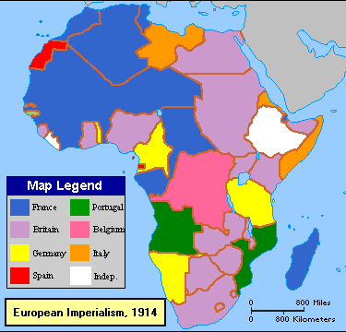

Slide 8
Internal Factors Enabling European Imperialism
Variety of Cultures & Languages
Low Level of Technology
Ethnic Strife

Slide 9
European Competition in Africa
West
Slave trade died down, changed to other natural resources (raw materials)
French fighting for Senegal
British fighting Ashanti in Gold Coast
Germany, Spain, Portugal also claim territories
Liberia only independent state-settled by former US slaves, US keeps it independent

Slide 10
European Competition in Africa
Central and East
Famine helps Europeans colonize East Africa; most cattle died from rinderpest; Africans too weak to resist
Belgian presence in the Congo setoff European race for colonies
No European power wanted to be left behind
Discoveries of Gold & Diamonds in South America also increased interest

Slide 11
European Competition in Africa
South
Dutch settlement at Cape Town, grows into Cape Colony; British take over
Boers, migration north and east=Great Trek, descendants of the Dutch settlers, establish three colonies, fight Zulus (Shaka) for years, British join fight and defeat Zulus
Germans in the southwest
Cecil Rhodes, Br. businessman-diamonds, Rhodesia

Slide 12
European Competition in Africa
South
Boer War: fight between Rhodes (British) and Boers in Transvaal over diamond mining, Britain wins- allows Boers to retain language, schools, etc., also provides funds for Boers to rebuild, creates voting laws ensuring white rule, the beginnings of South Africa’s racial segregation (Apartheid)

Slide 13
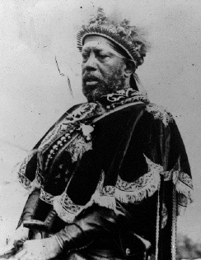
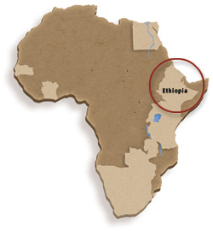
Ethiopia- A Successful Resistance
Menelik II Emperor of Ethiopia
Purchases weapons from France & Russia
Defeated Italian forces in 1896
Only African nation to resist Europeans

Slide 14
Positive Impacts of Colonial Rule
Reduced local warfare
Improved sanitation, hospitals/medicines & education
African products popular in European Market
Improved methods of farming
Improved infrastructure: Railroads, dams, telephones & telegraph lines

Slide 15
Negative Impacts of Colonial Rule
Lost land & independence
Death caused by new disease & resistance
Change to cash crops resulted in famine
Breakdown of traditional culture
European establishment of boundaries (Problem today)

