Slide 1
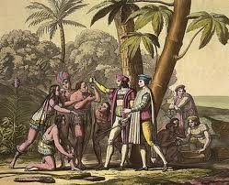
Columbian Exchange

Slide 2
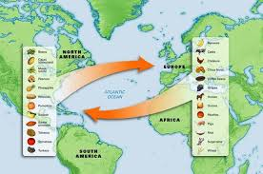
Columbian Exchange

Slide 3
Columbian Exchange
Widespread exchange of animals, plants, culture, human populations (including slaves), communicable disease, technology and ideas between the American and Afro-Eurasian hemispheres following the voyage to the Americas by Christopher Columbus
The term was coined in 1972 by Alfred W. Crosby, a historian at the University of Texas, in his work of environmental history

Slide 4
Columbian Exchange
contact between the two areas circulated a wide variety of new crops and livestock which supported increases in population in both hemispheres
European exploration of tropical areas was aided by the New World discovery of quinine, the first effective treatment for malaria

Slide 5
Columbian Exchange
Explorers returned to Europe with maize, potatoes, and tomatoes, which became very important crops in Europe by the 18th century
Europeans introduced manioc and peanut to tropical Asia/West Africa, where they flourished and supported growth in populations
One of the first European exports, the horse, changed the lives of many Native American tribes on the mountains, allowing them to shift to a nomadic lifestyle based on hunting bison on horseback
Portuguese introduced chili/paprika from South America to India-today it is an integral part of Indian cuisine

Slide 6
Columbian Exchange
"Old World" diseases had a devastating impact on Native American populations because they had no natural immunity to the new diseases
Smallpox epidemics are believed to have resulted in the largest death tolls among Native Americans (far exceeding the loss of life due to the Black Death)
It is estimated that 80–95% of the Native American population died in these epidemics within the first 100–150 years following 1492

Slide 7
Columbian Exchange
Old World to New World
Cat
Chicken
Cow
Horse
Pig
Rice
Sugarcane
Wheat (Midwest US)
New World to Old World
Alpaca
Llama
Beans
Chili peppers (India/China)
Cocoa (Switzerland)
Cotton
Maize
Manioc

Slide 8
Columbian Exchange
Old World to New World
Banana
Black pepper
Carrot
Coffee
Hemp (Kentucky)
Peach (Georgia)
New World to Old World
Peanut
Potato (Ireland)
Sweet potato
Tobacco (all of Europe)
Tomato (Italy)
Gold
Silver

