Slide 1
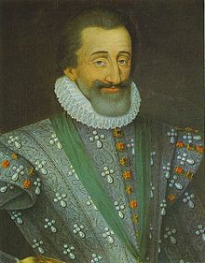
Age of Absolutism: France

Slide 2
Henry IV
Assumes throne 1589
New line of rulers-House of the Bourbons
Huguenot, converts to Catholicism to help bring peace and unity
Edict of Nantes: guarantees religious freedoms and ends the religious wars
Tried to solve many of France’s major problems, controlling the nobility

Slide 3
Henry IV
Tried to fix French tax system
Many exempt from tax: nobles, clergy, citizens of large cities such as Paris
Burden falls to lower and middle classes
Country has been weakened from burden of the expense of frequent wars

Slide 4
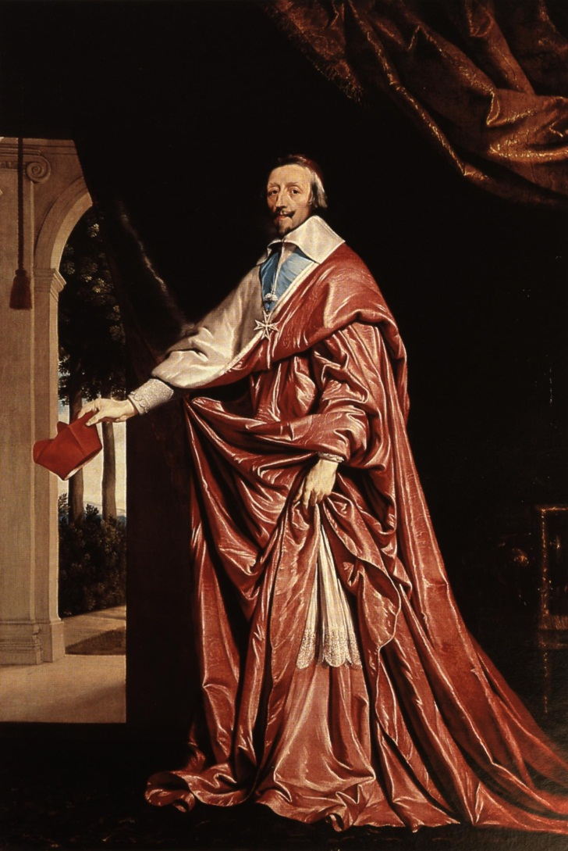
Cardinal Richelieu
Henry IV murdered 1610
son Louis XIII (8 yr) takes throne
mother rules until he is 15
he is sickly, so chooses Richelieu to be chief minister
Richelieu effectively runs France 1624-1642

Slide 5
Cardinal Richelieu
Strengthened the monarchy
Took power from nobles
Strengthened power of “intendants”: representatives of the king
Encouraged trade and industry
Destroyed any fortified castle not needed for defense
Restricted some of the freedoms previously given to the Huguenots; takes away their fortified cities; takes away special rights they had enjoyed under the Edict of Nantes

Slide 6
Cardinal Richelieu
Thirty Years’ War 1618
Protestant rebellion against HRE
War involved HRE, Denmark, Sweden, France
Richelieu works to keep France out of direct war, but keeps war going, thus weakening all other countries
Treaty of Westphalia 1648 (weakens HRE)
France receives Alsace
Netherlands and Switzerland become independent
Germanic princes become independent of HRE

Slide 7
Louis XIV
Becomes king in 1643 at age 4; ruled for 72 years, longest of any French king
Worked to continue to strengthen crown
Takes the sun as personal symbol – The Sun King

Slide 8
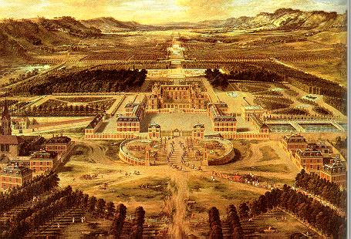
Louis XIV
Built enormous palace at Versailles
Moved government there
The expense strained the French economy
Brought nobles there to live so he could keep an eye on them
Becomes symbol of French power and majesty throughout Europe

Slide 9
Louis XIV
Believed in “Divine Right of Kings”
Jean-Baptiste Colbert, finance minister
Policies to promote industry at home
High tariffs on foreign imports
Establish colonies: Canada, East Asia, West Indies
Reform tax system-eliminate exemptions to make it more fair
France becomes leading economic power, naval power, and strong force in overseas trade and colonization

Slide 10
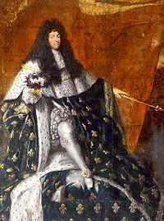
Louis XIV
Reverses the Edict of Nantes in 1685; believes the Huguenots weaken the central government
More than 200,000 flee France
Weakens French economy in long run

Slide 11
Louis XIV
French army had become most powerful in Europe
Louis believed France needed natural borders for security
Fights several wars to extend territory to the Rhine River
Alarms European countries who ally themselves together against France to create a “balance of power”

Slide 12
Louis XIV
War of Spanish Succession
Fought over who would become next Spanish king
Spanish king dies in 1700 with no child heir; next in line is Philip V, Louis XIV’s grandson
Other European nations did not like Spain and France being ruled by one family (the Bourbons)
War breaks out in Europe, North America, and at sea
Treaty of Utrecht-1713
France is defeated
Philip V may become king, but families could not unite
France had to give lands in North America to GB

Slide 13
Legacy of Louis XIV
France begins lose some of its political and military power
France continues exploration and colonization
Wars take toll on economy and large loss of life
Louis XIV dies 1715; decline of royal authority begins

